Slide 1
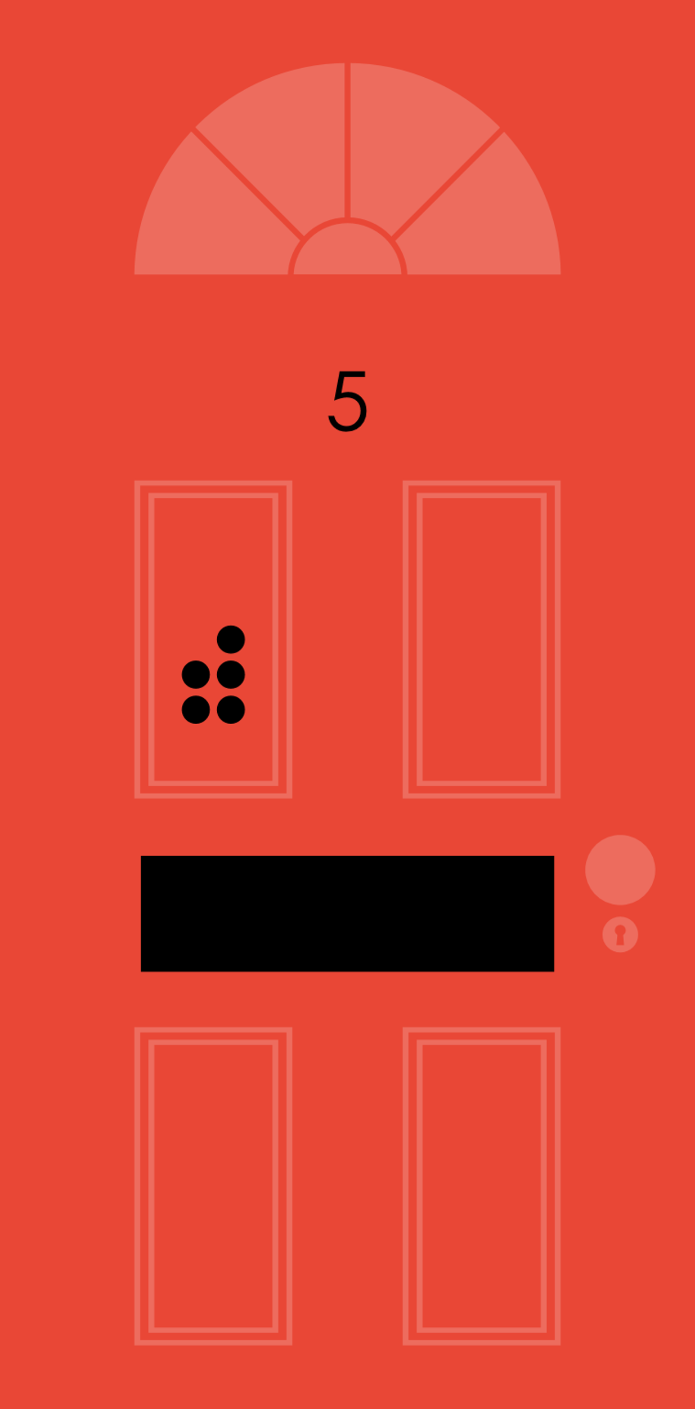
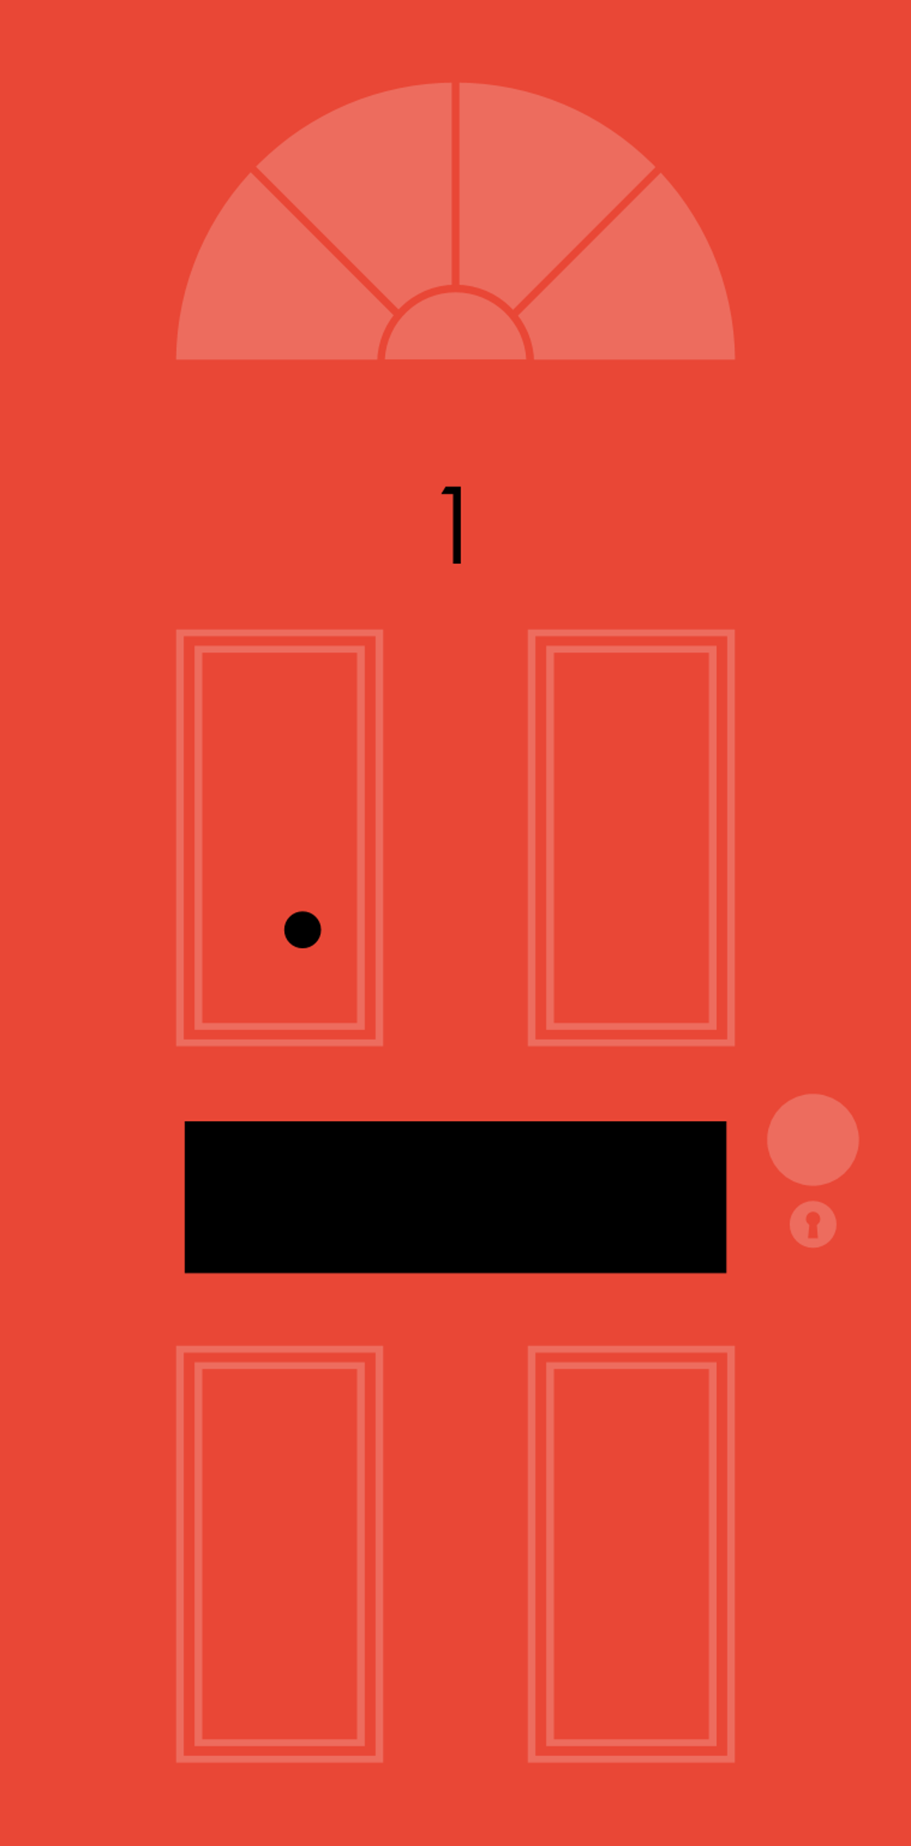
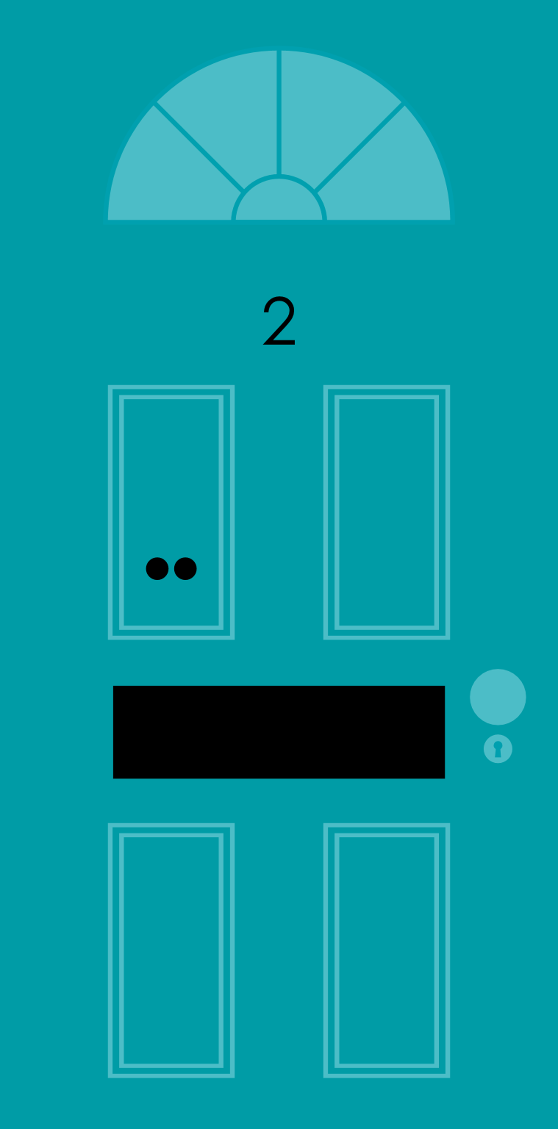
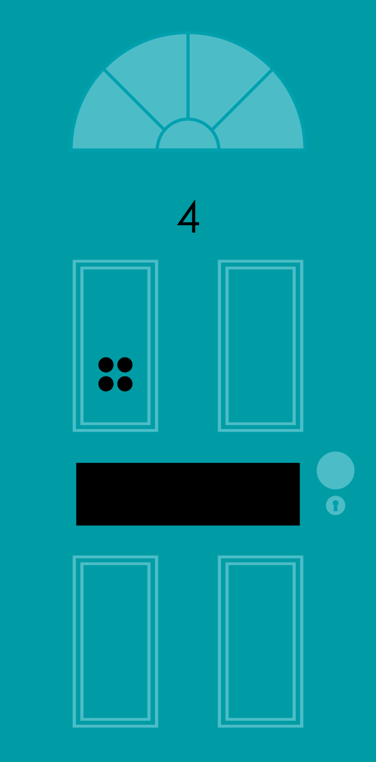
Sequence the Streets
Let’s get sorted!

Slide 2
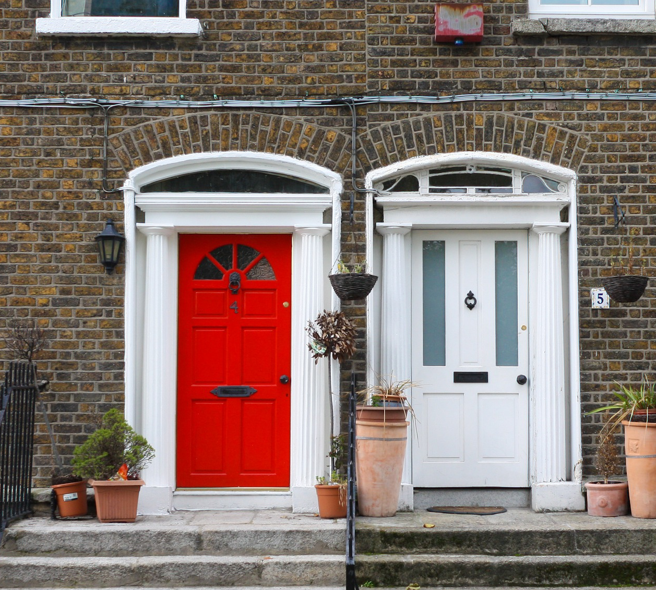
Door numbers
Have you noticed that most houses and flats have a number?

Slide 3
Knock - knock
The number allows people to find the correct address

Slide 4
Sometimes the door numbers count in 1’s
one
two
three
four

Slide 5
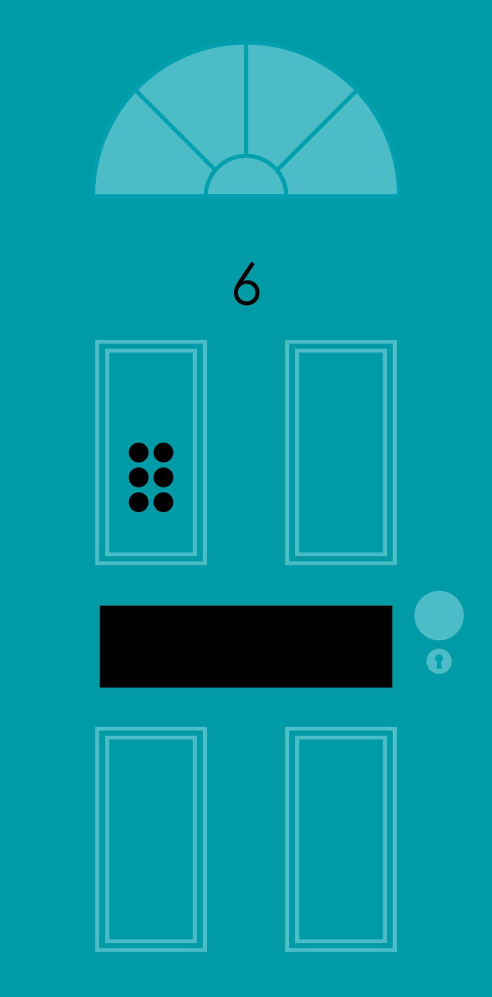
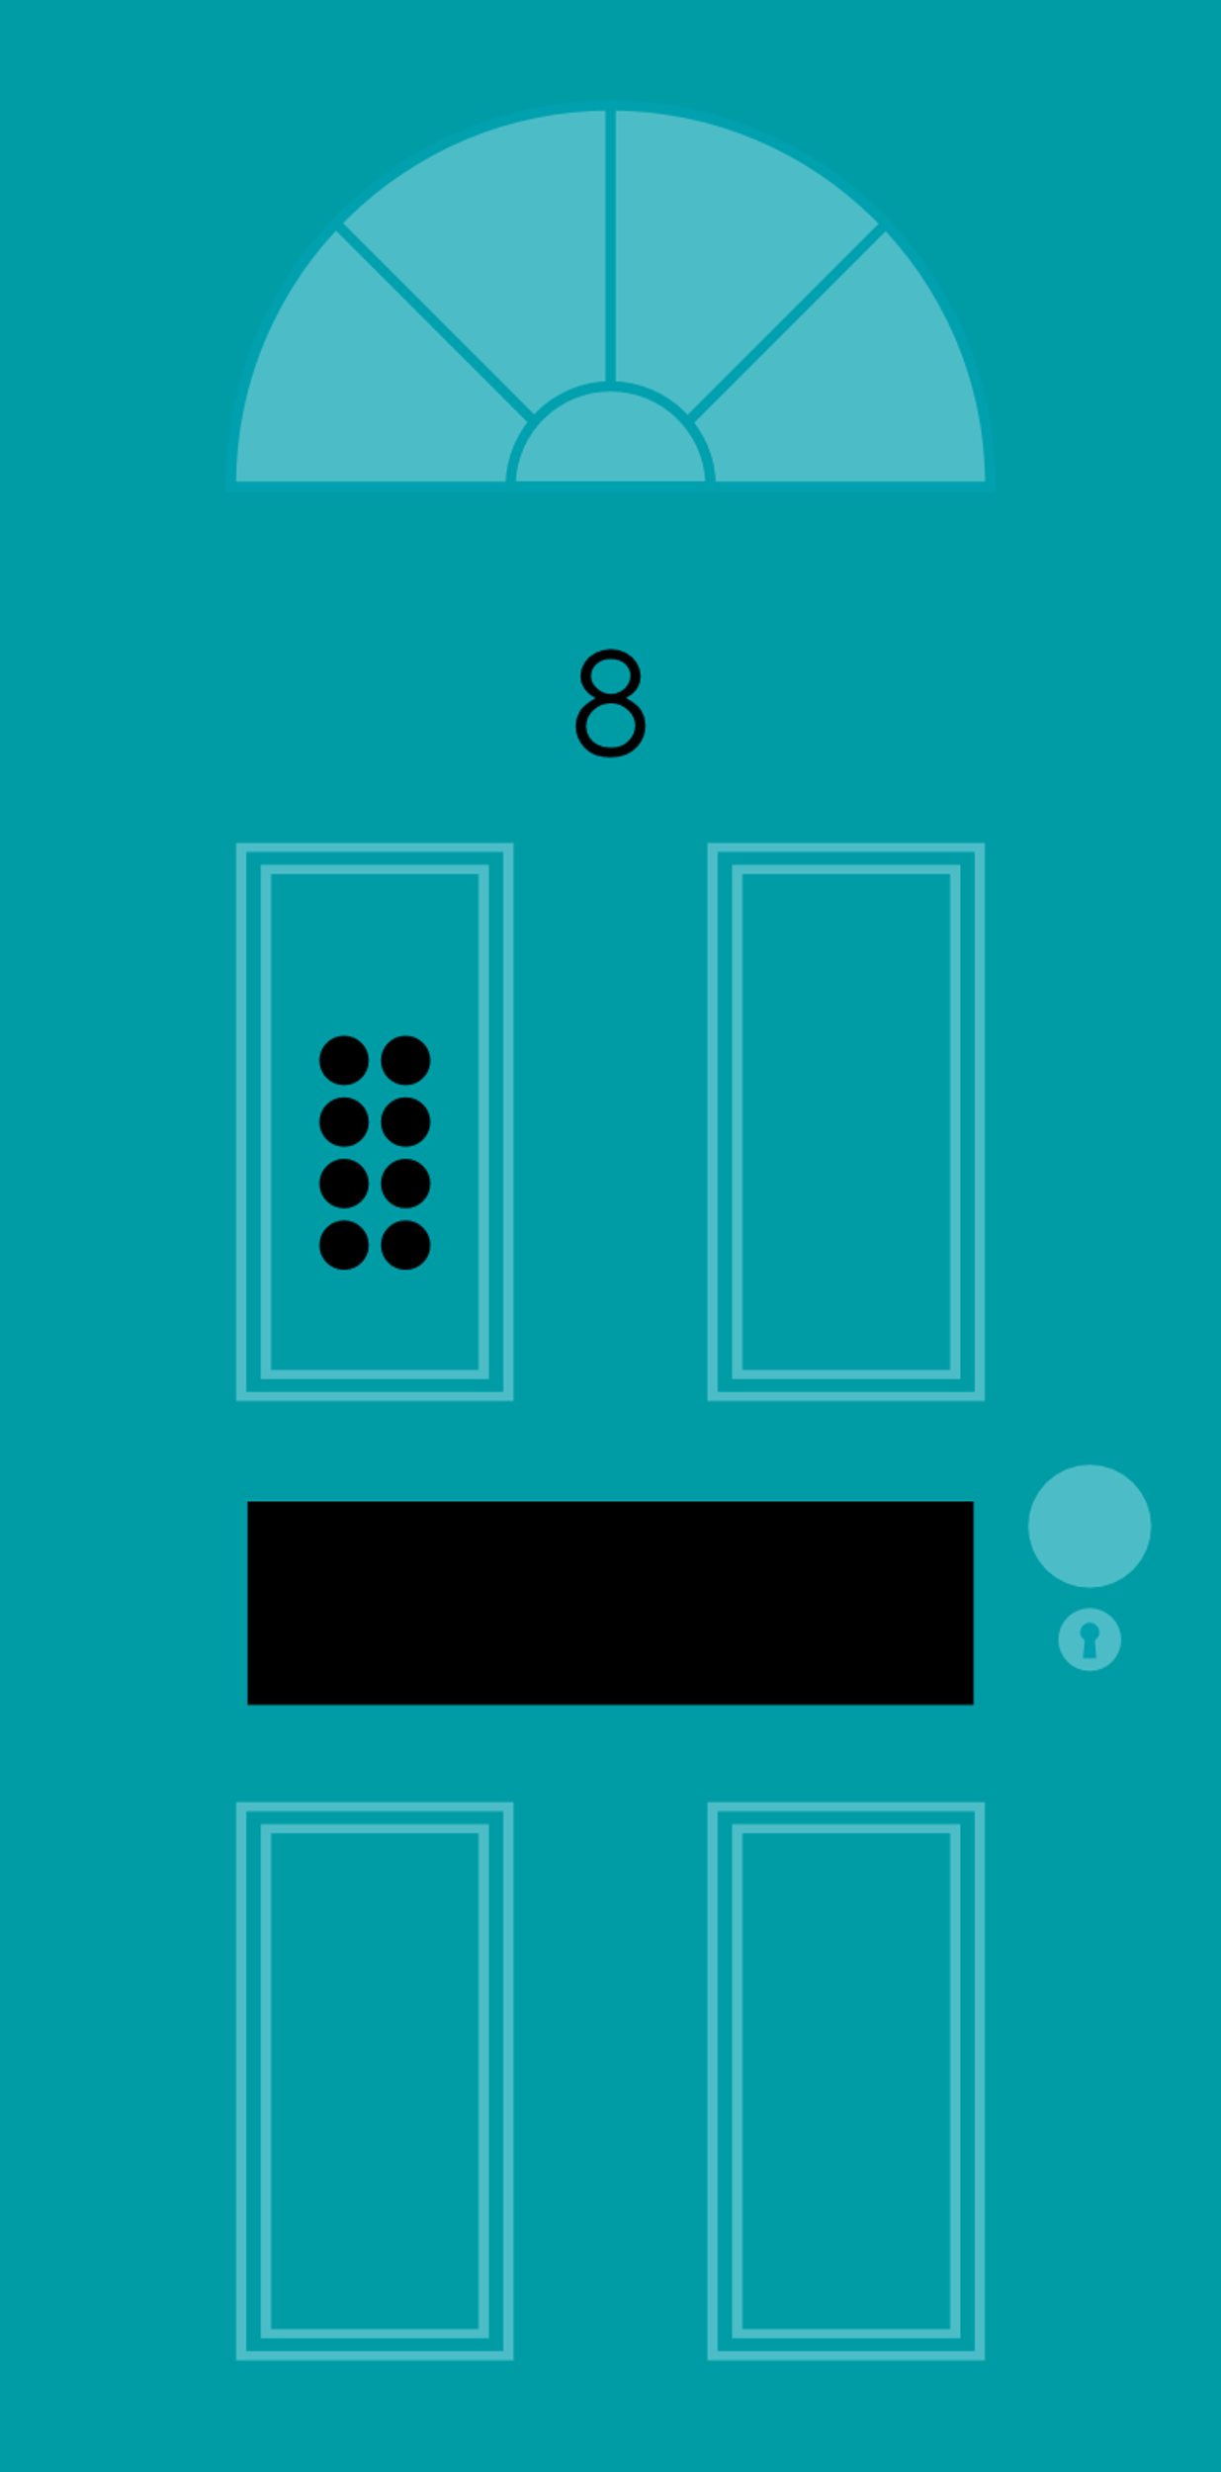
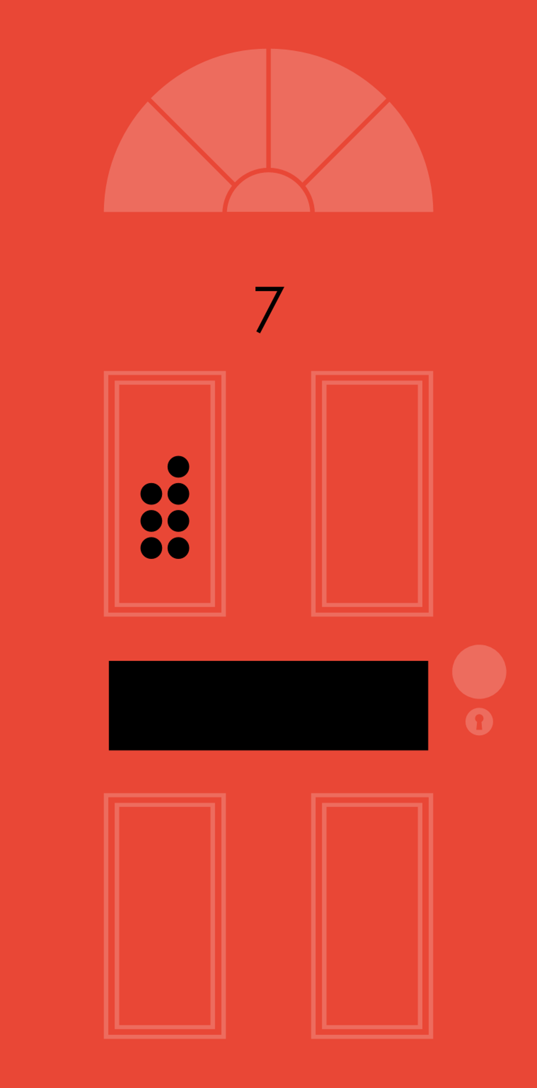
even
Usually
the door numbers count in 2’s
two
four
six
eight
odd
one
three
five
seven

Slide 6
Ready for the challenge?
Let’s get sorted!

Slide 7
What is the missing number?
5
6
7
Try again
Try again

Slide 8
5
The missing number was
Next

Slide 9
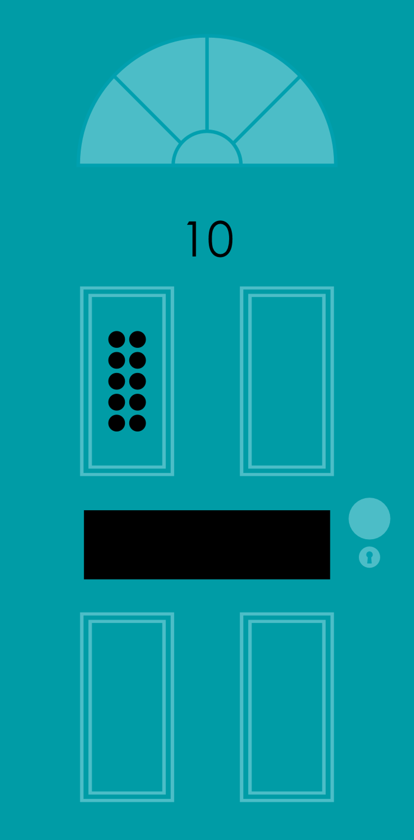
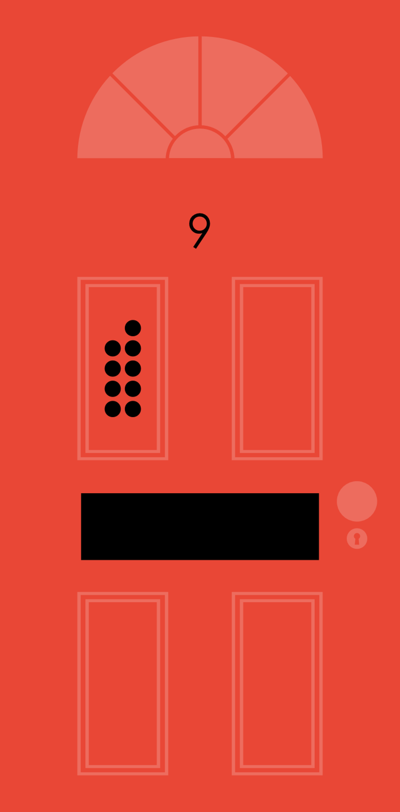
What is the missing number?
5
6
7
Try again
Try again

Slide 10
7
The missing number was
Next

Slide 11
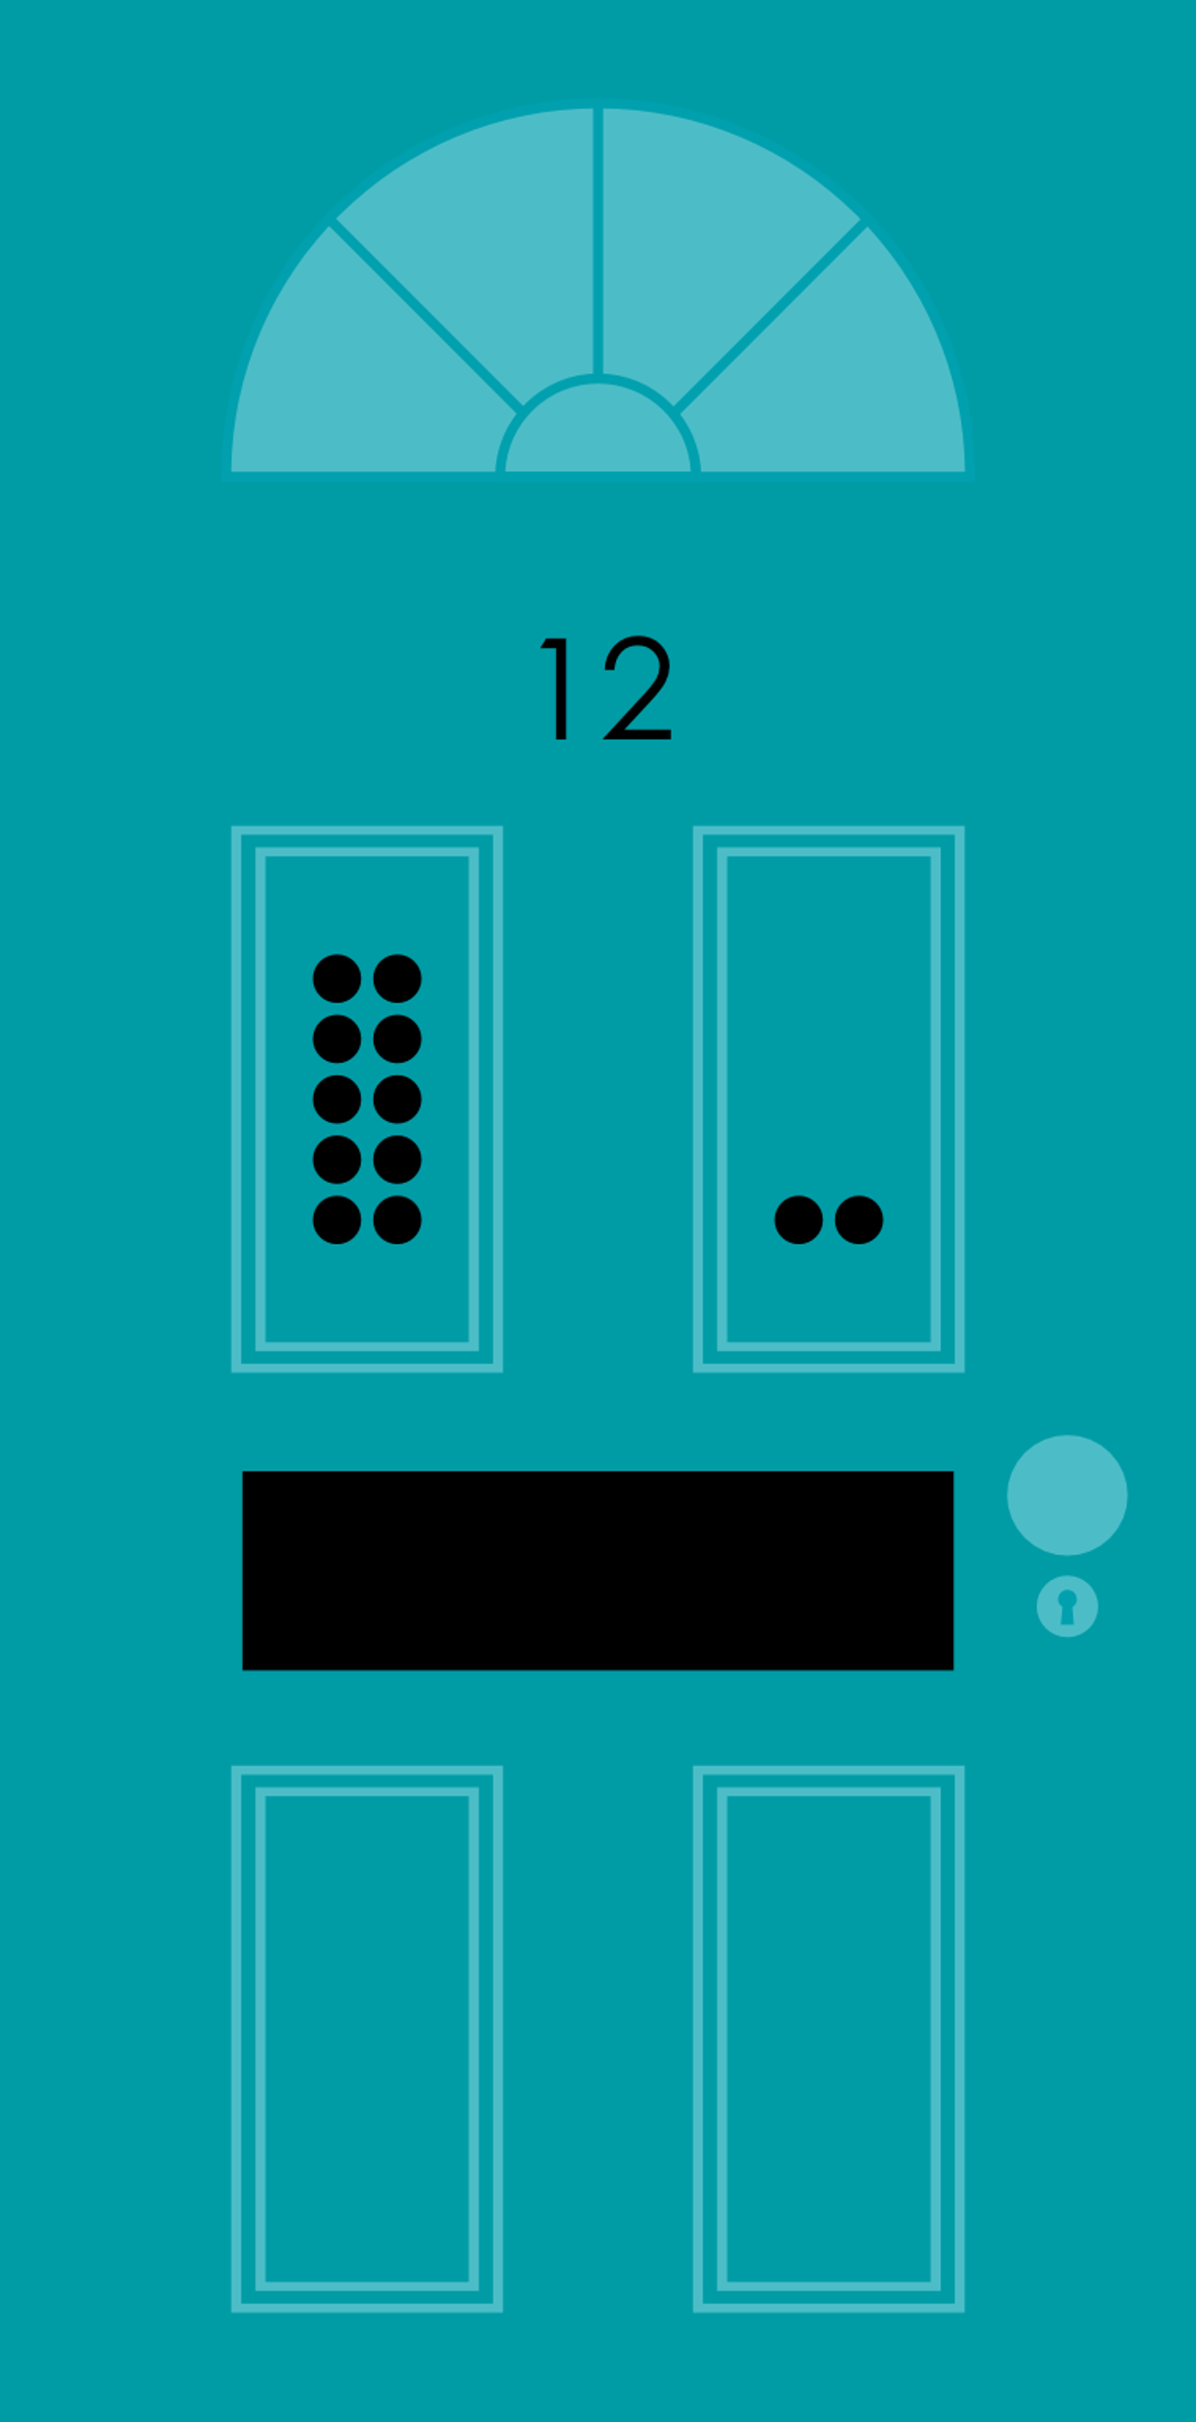
What is the missing number?
7
9
10
Try again
Try again

Slide 12
10
The missing number was
Next

Slide 13
What is the missing number?
2
3
4
Try again
Try again

Slide 14
3
The missing number was
Next

Slide 15
What is the missing number?
5
6
7
Try again
Try again

Slide 16
7
The missing number was
Next

Slide 17
Well done! You sequenced all the streets.
Sorted!

