Slide 1
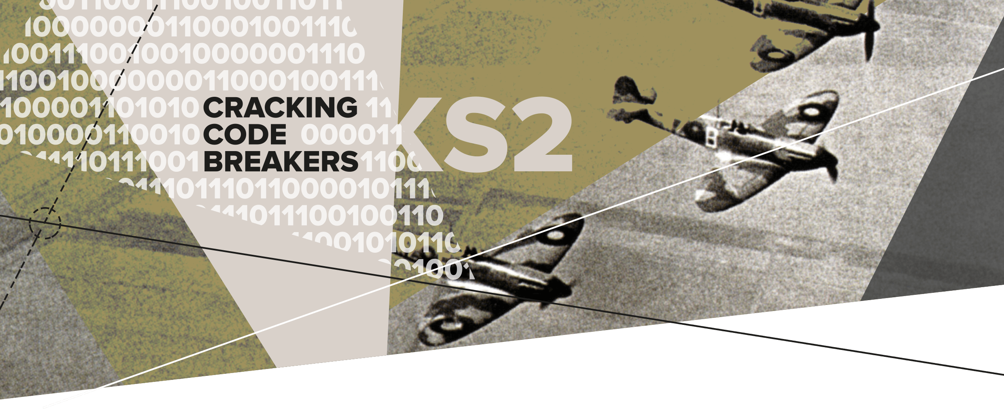
05 – Cracking the Code
Key words:
Intercept | Decipher | Translate

Slide 2
Humans and machines
During the Second World War people worked tirelessly to help to put an end to the conflict.
The Allies (the British) wanted to crack the German coded messages to gain a war advantage.
Even though the Colossus was fast, humans were still needed to operate the machines and to finish off the deciphering process.
Notes:
An ADVANTAGE is an opportunity to put yourself in a better position.

Slide 3
Keyword: Intercept
Intercept means to obtain something that is meant to be for someone else.
In the Second World War, the British intercepted messages from the Germans.
The intercepted messages contained secret battle information.
Working out what they said was very important.

Slide 4
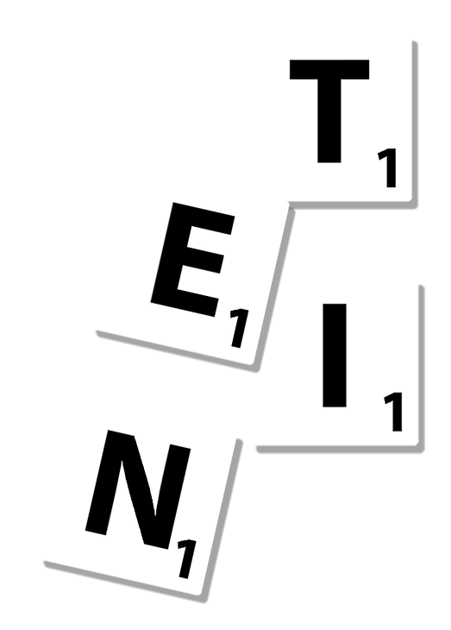
Keyword: Decipher
Decipher means to convert a coded message or signal to a normal, readable message.
Colossus helped to decipher cryptic messages.
The British noticed that messages sometimes started or ended with the same words. This provided clues to decipher the rest of the message.
Looking out for common letters is also a good technique to decipher a message.
Notes:
Teachers’ Notes:
The British noticed that important messages sometimes started or ended with the same words e.g. “Adolf Hitler, Führer”.
The letters T, E, and I are common letters in English (This is why they have a low score in Scrabble)
Other deciphering techniques include looking out for common letters and patterns like double letters.

Slide 5
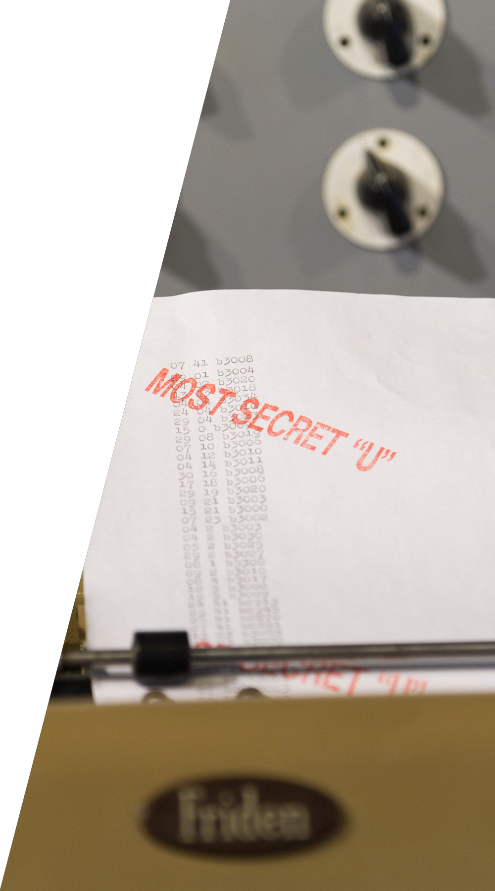
Key word: Translate
Translate means to convert one language into another.
Remember that not only were the Tunny messages encrypted but they were also in a foreign language.
The cryptographers had to be good at translating German.

Slide 6
Become a code breaker
Colossus didn’t fully crack the codes, it needed people to help.
Can you use code breaking techniques to help to decipher the cryptic messages as fast as possible?
Notes:
Understanding how often letters in the alphabet are used helped the cryptographers to figure out a pattern in the encrypted messages.

