Slide 1
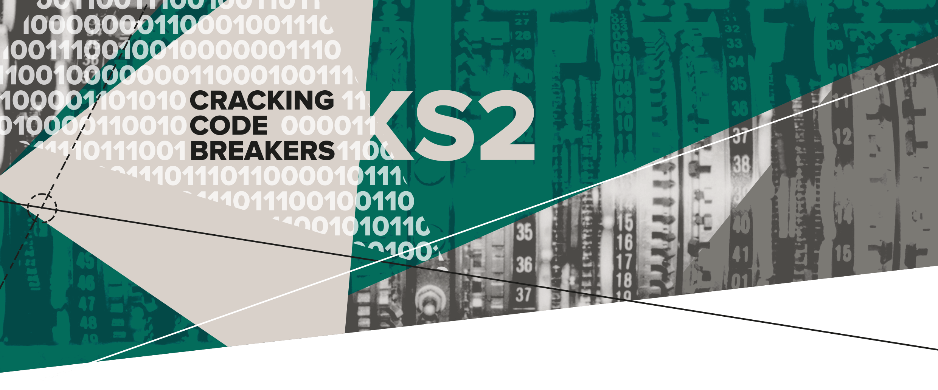
04 – Cryptic Messages
Key words:
Cryptography | Binary | Cipher

Slide 2
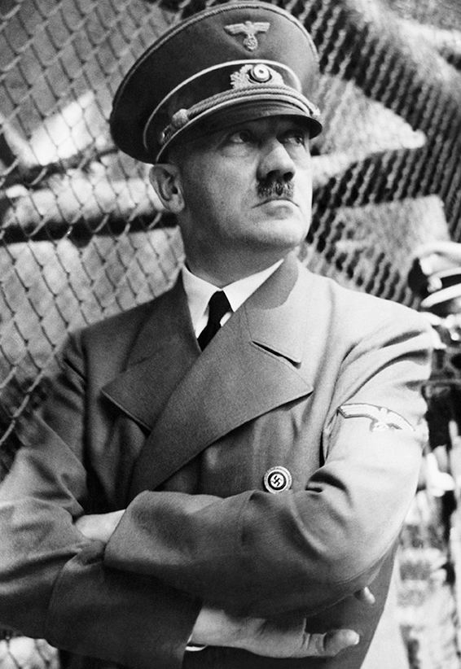
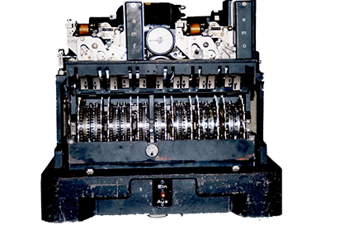
Second World War communication
Both sides of the conflict used teleprinters to communicate over long distances.
Hitler, the German leader, was using the Lorenz machine (the Tunny) to send secret messages to his generals.
The messages helped to plan their attack and defence.
Notes:
Teachers’ Notes:
The Image shows Hitler and the German Lorenz machine which the British nicknamed the Tunny.
The Lorenz machine converted messages into top secret code.

Slide 3
Key word: Cryptography
Cryptography is the process of creating or solving secret messages.
A key is a system used to convert a messages into a secret code and back again.
Cryptographers work to solve the key and understand the message.

Slide 4
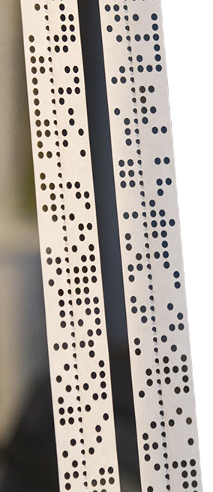
Key word: Binary
Binary is a number scheme where the only value is 0 or 1.
Computers still work in binary today.
Each letter has a five digit code made up of 0’s and 1’s
Example: A is 11000, B is 10011, C is 01110
Tapes punched with holes were a way of reading and writing binary.
Notes:
Teachers’ Notes
German messages sent in the war were based on binary.
Tapes with holes punched in were a way of reading and writing the binary code.
1 = a punched hole 0 = no hole
Please note, the smaller holes down the centre of the tape are the registration holes which secure the tape to the machine.

Slide 5
Key word: Cipher
A | = | F
B | = | S
C | = | T
D | = | U
E | = | M
F | = | L
G | = | V
H | = | E
I | = | B
J | = | A
K | = | K
L | = | P
M | = | O
N | = | H
O | = | X
P | = | Y
Q | = | I
R | = | C
S | = | G
T | = | J
U | = | R
V | = | W
W | = | Q
X | = | Z
Y | = | D
Z | = | N
Cipher Key
A cipher is way of writing a word or message in a secret code.
A letter is represented by a different letter, symbol or character.
A cipher key enables a word to be disguised.
Can you decrypt this enciphered word?
Use the key to help.
GMTCMJ
Notes:
Teachers’ Notes
The plaintext letters are on the left columns, the ciphered letters are on the right columns
The enciphered word is SECRET

Slide 6
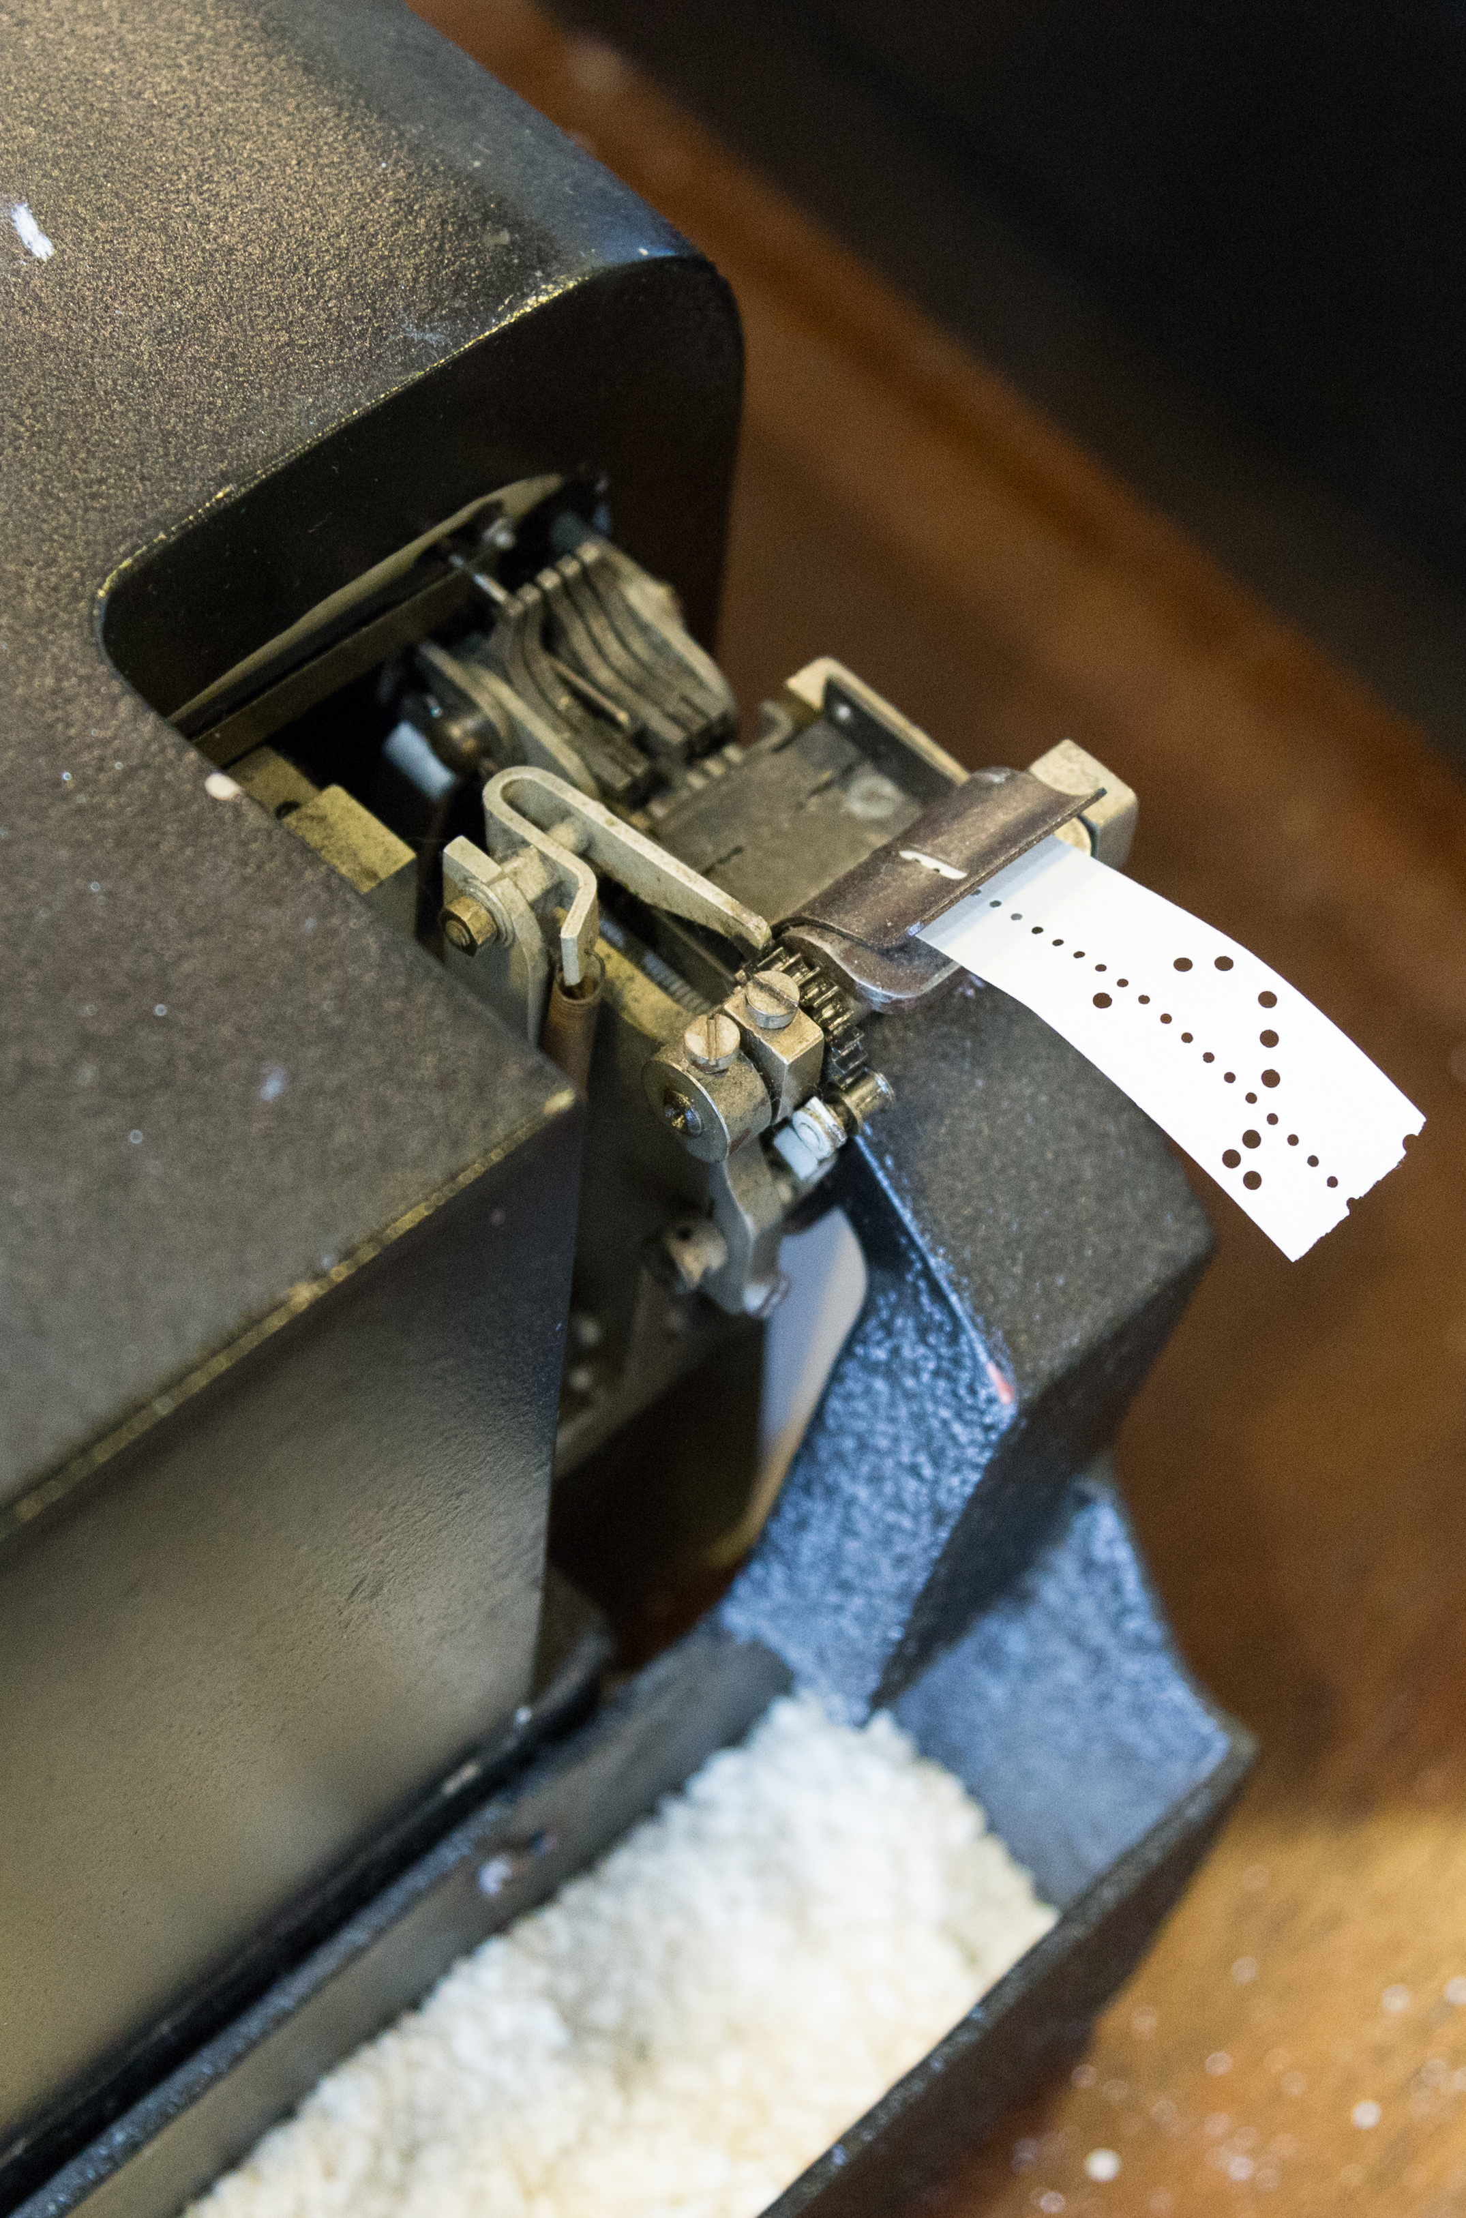
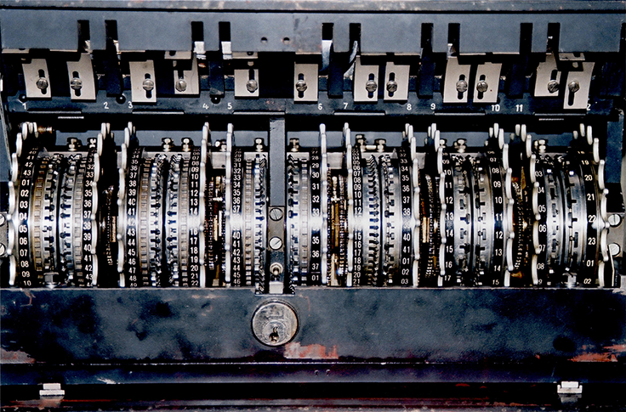
Making secret messages
We’re going to make our own cipher process based on some elements of the Tunny.
By using a key we’ll examine how words can be disguised!
Notes:
The images show a tape-punching device and the wheel settings of a Lorenz cipher machine (the Tunny).

