Slide 1
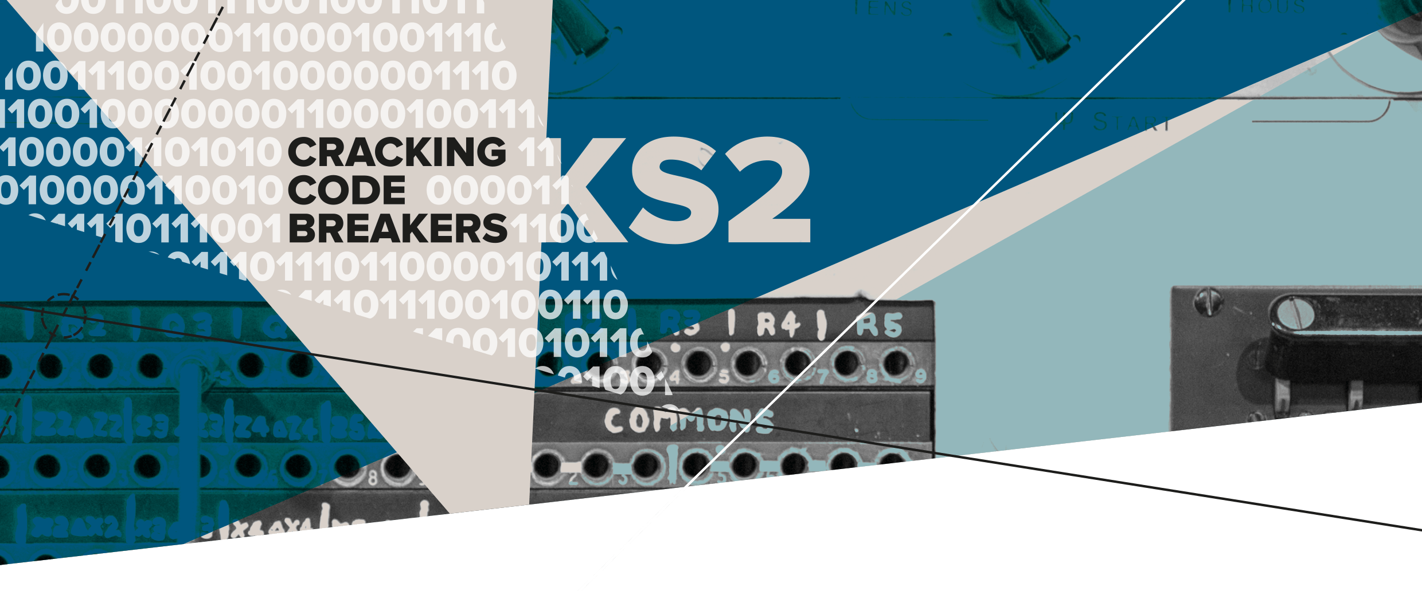
02 – Tommy Who?
Key words:
Apprentice | Invention | Colossus

Slide 2
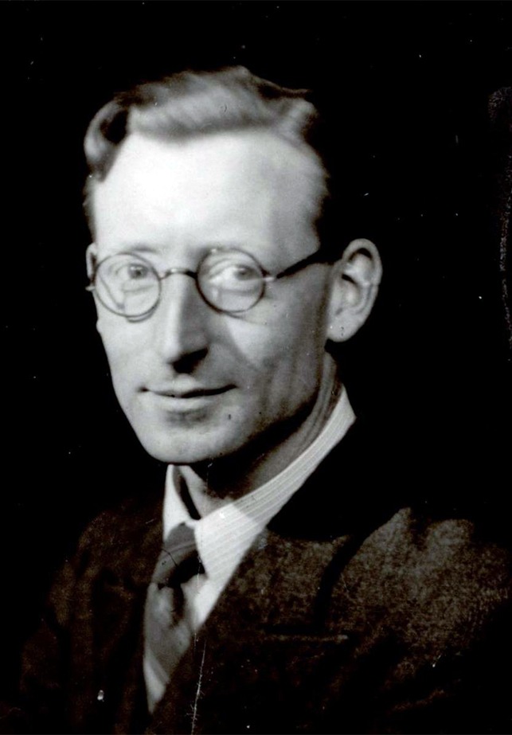
Tommy Flowers and Colossus
Tommy was an engineer at the General Post Office (GPO) Research Station at Dollis Hill in London.
Tommy designed the Colossus machine to increase the speed and accuracy of breaking coded messages sent between top German generals and sometimes Hitler himself.
Here is a coded word… Can you break it?
D P M P T T V T
C O L O S S U S
Tommy Flowers
Notes:
Teachers’ Notes
Tommy Flowers grew up in London's East End being surrounded and inspired by his father’s bricklaying tools.
Write out the alphabet on the board.
Give the students a clue, The first letter is a C ….
In this coded word the T’s are actually S’s
Notice the pattern? The real letter comes before the coded letter in the alphabet.
The coded word is COLOSSUS
More code-breaking activities can be found in sections 5 and 6 of the ‘Cracking Code Breakers resource.

Slide 3
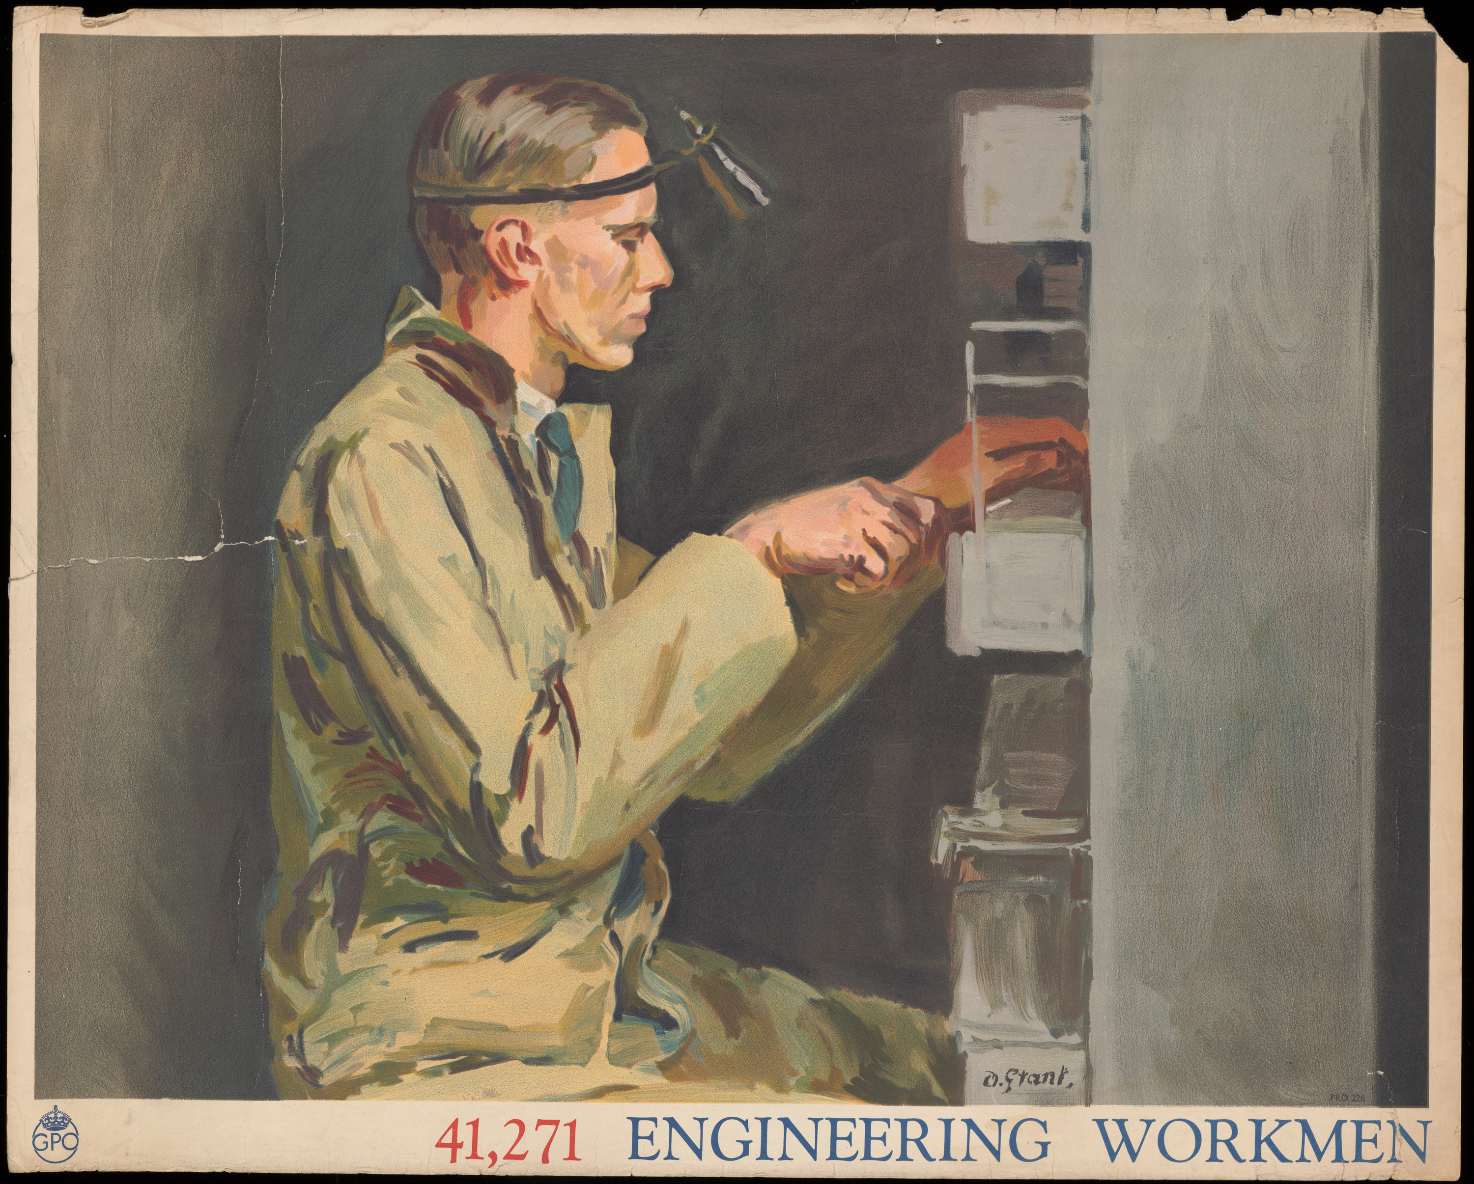
Key word: Apprentice
Tommy worked as an apprentice at the Royal Arsenal in Woolwich.
An apprentice learns a skill or trade whilst being employed.
Apprentices often study at college alongside training on the job.
Notes:
Teachers notes:
Tommy went to school in East Ham and studied at the local college until he was 16. He then worked as an apprentice and attended college in the evenings.

Slide 4
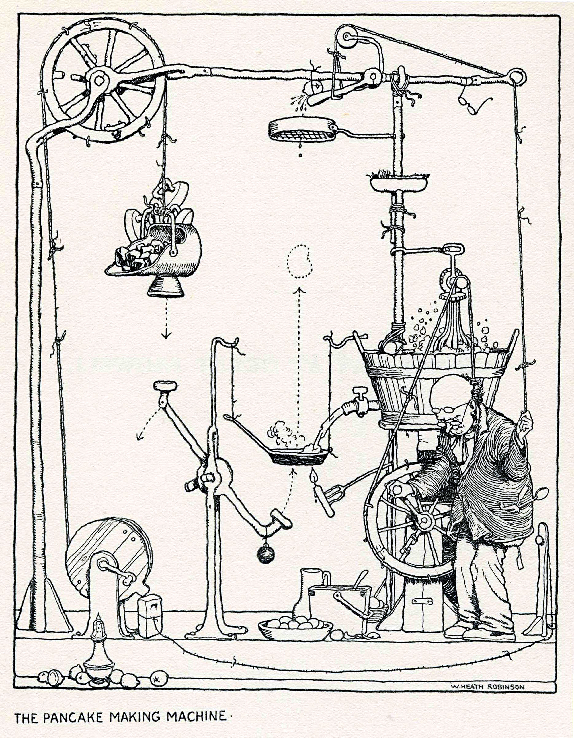
Keyword: Invention
An invention is a new or unique device or way of doing something.
Inventions usually aim to solve a problem or improve an existing design.
Colossus was a new invention!
An invention illustration by William Heath Robinson.
© The Heath Robinson Museum.
Notes:
Teachers’ Notes
The illustration is by William Heath Robinson. He was an English artist known for drawings of comical and complicated machines.
The previous code breaking machine before Colossus was nicknamed the ‘Heath Robinson’. Tommy Flowers thought he could come up with a new invention which would work faster and more efficiently than the ‘Heath Robinson’.

Slide 5
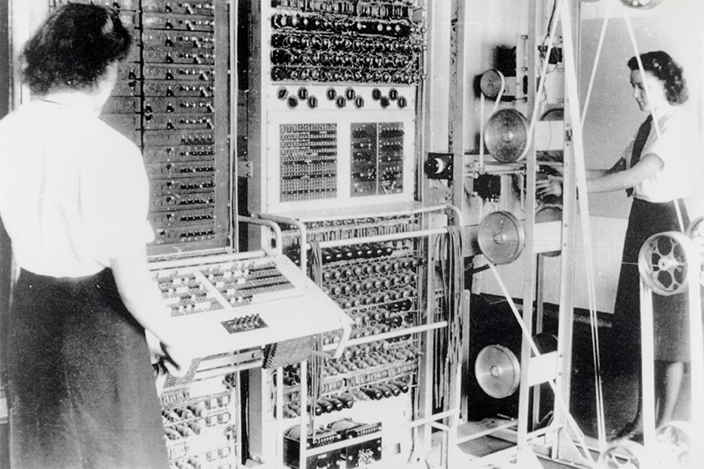
Key word: Colossus
Colossus was the first programmable electronic computer. It was used to help to break coded messages sent between the top German generals.
Colossus was the size of a large classroom.
There were 10 Colossi built in total and these were mostly operated by Wrens (Women’s Royal Naval Service).
Wrens operate Colossus at Bletchley Park.
© Science and Society Picture Library.

Slide 6
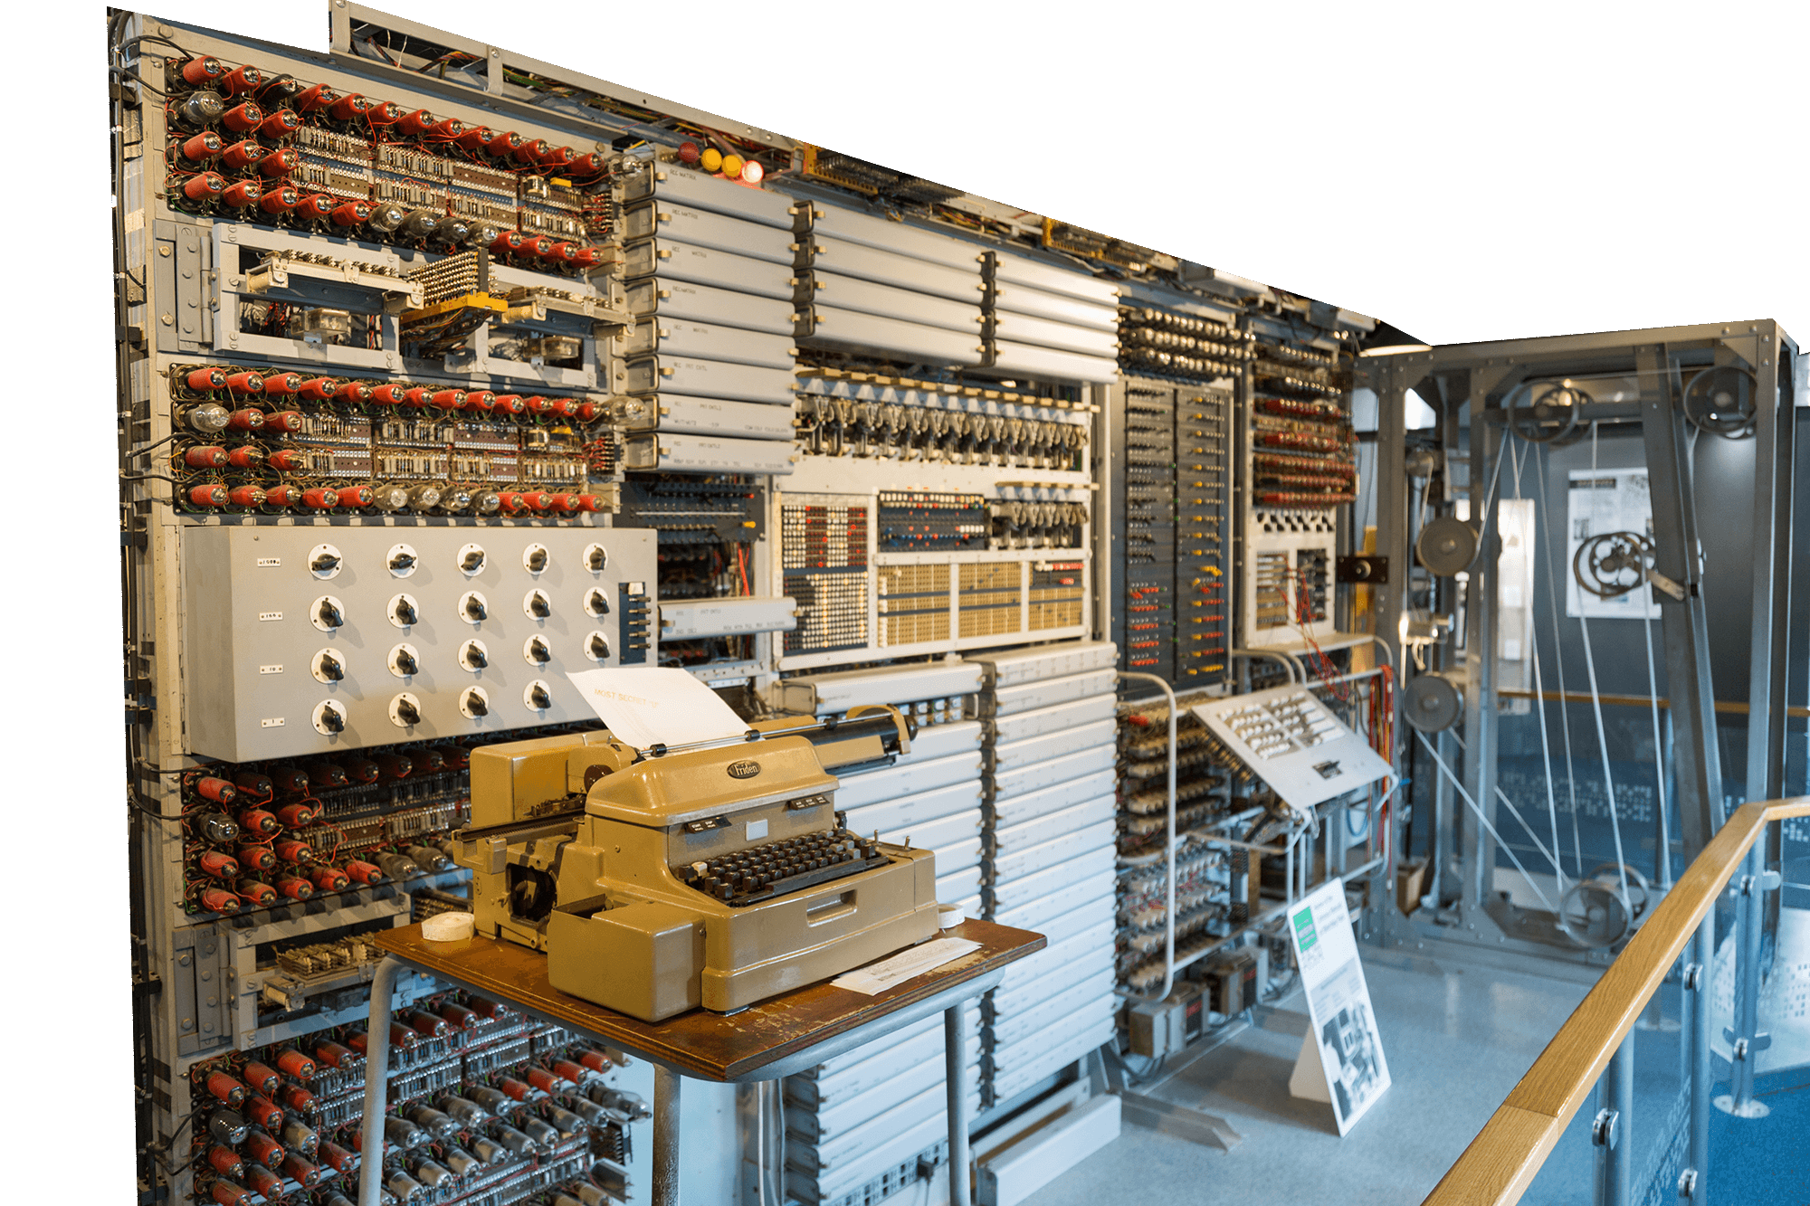
Today you are going to be an inventor
Your task is to design a new machine.
Your invention should aim to solve a problem
in the 21st century.
Let’s begin by finding a
problem to solve...

