Slide 1
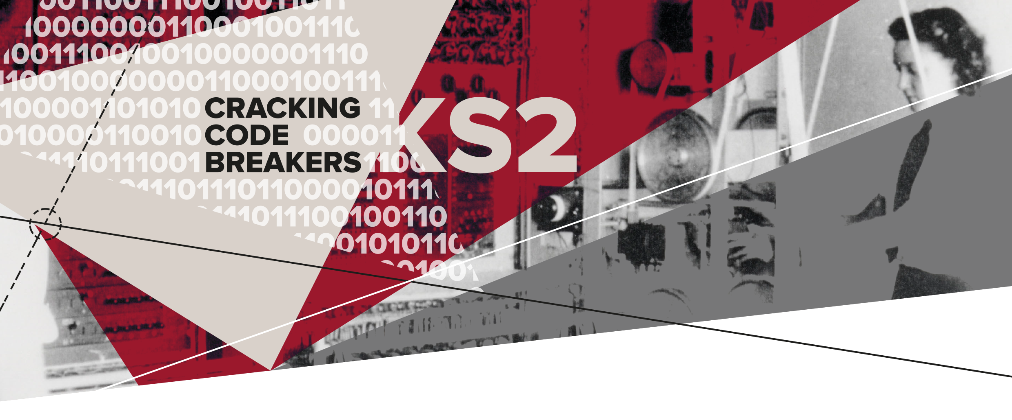
01 – The General Post Office (GPO) The Heart of Communication
Key words:
Engineer | Teleprinter | Encrypted

Slide 2
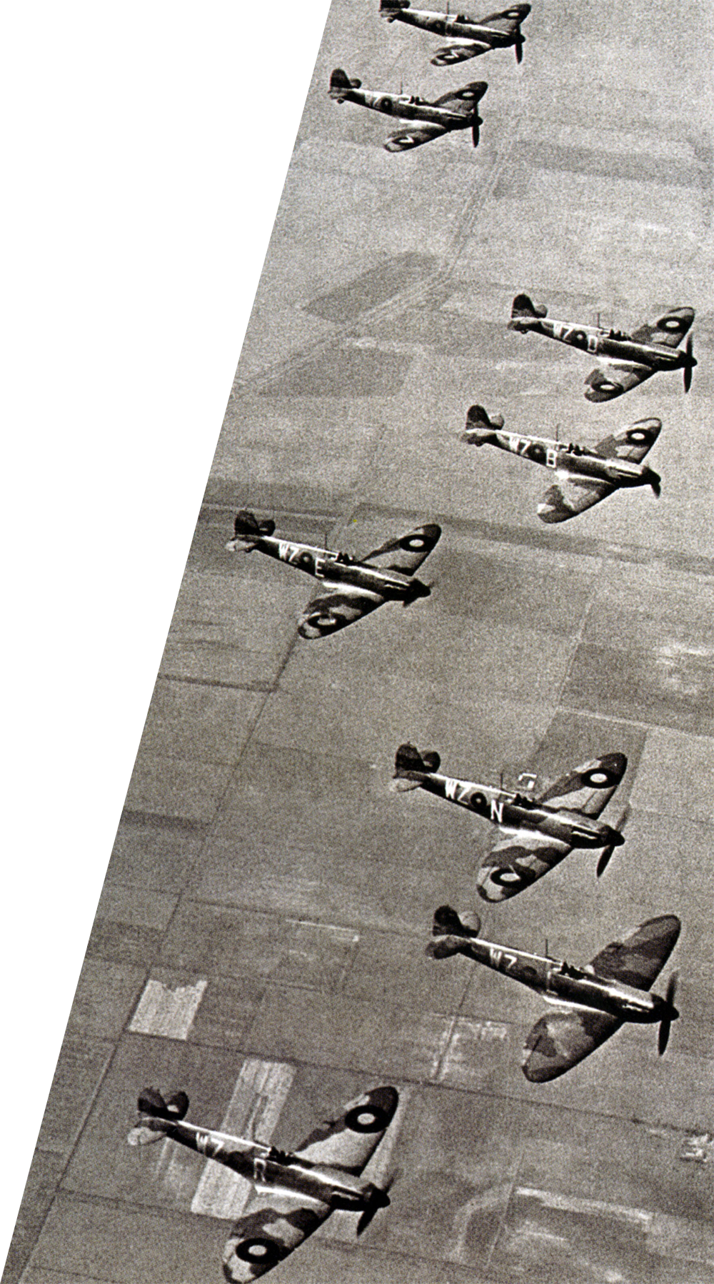
The heart of communication
The General Post Office (GPO) was very important for communication during the Second World War.
There were no mobile phones and the Internet had not been invented.
Notes:
Teachers’ Notes
Today we associate the Post Office with letters and parcels but for most of the twentieth century and in the Second World War it was responsible for all communications. It was known as The General Post Office (GPO)
Imagine communicating in a world without mobile phones, emails, social media or even the internet.
What icons do you recognise? Could you manage without them?

Slide 3
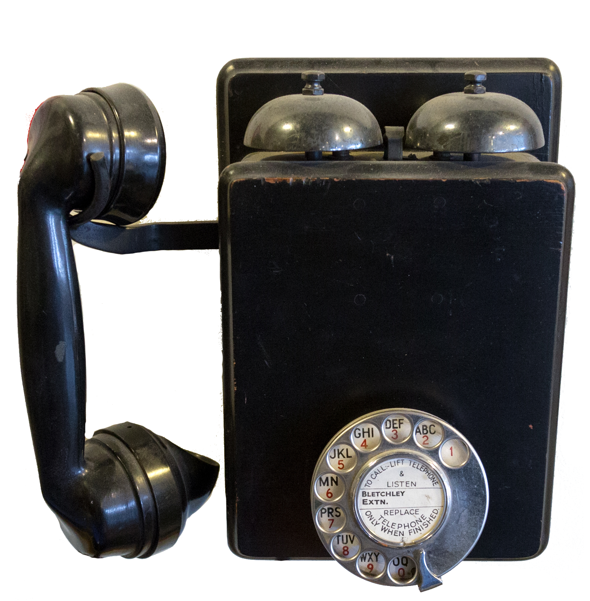
Wartime communication
The General Post Office looked after the radio, early television, telephone and teleprinter networks.
The General Post Office employed engineers who used lots of skills to invent new technologies to speed up communication.

Slide 4
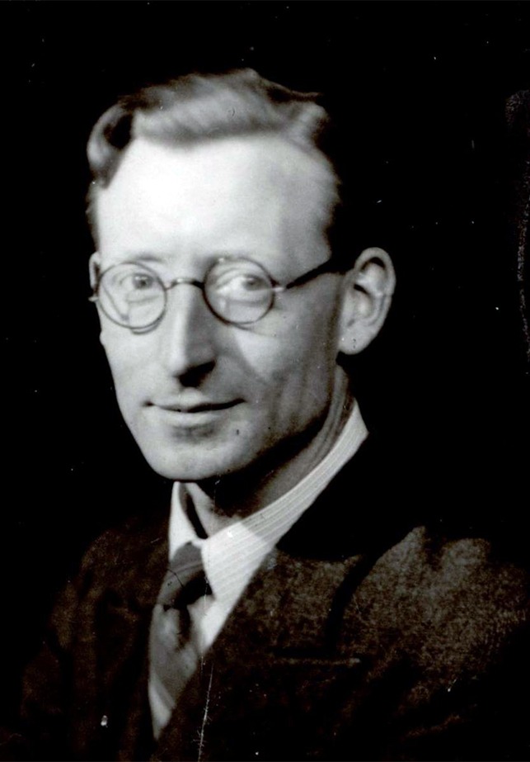
Key word: Engineer
An engineer is a person who designs, builds or maintains engines and machines.
Engineers are good at finding solutions to problems.
Tommy Flowers was employed as an engineer at the General Post Office.
Tommy Flowers
Notes:
Teachers’ Notes
Tommy Flowers designed Colossus – a code breaking machine which helped to decrypt the German teleprinter messages.
We will find out more about Tommy Flowers in activity two.

Slide 5
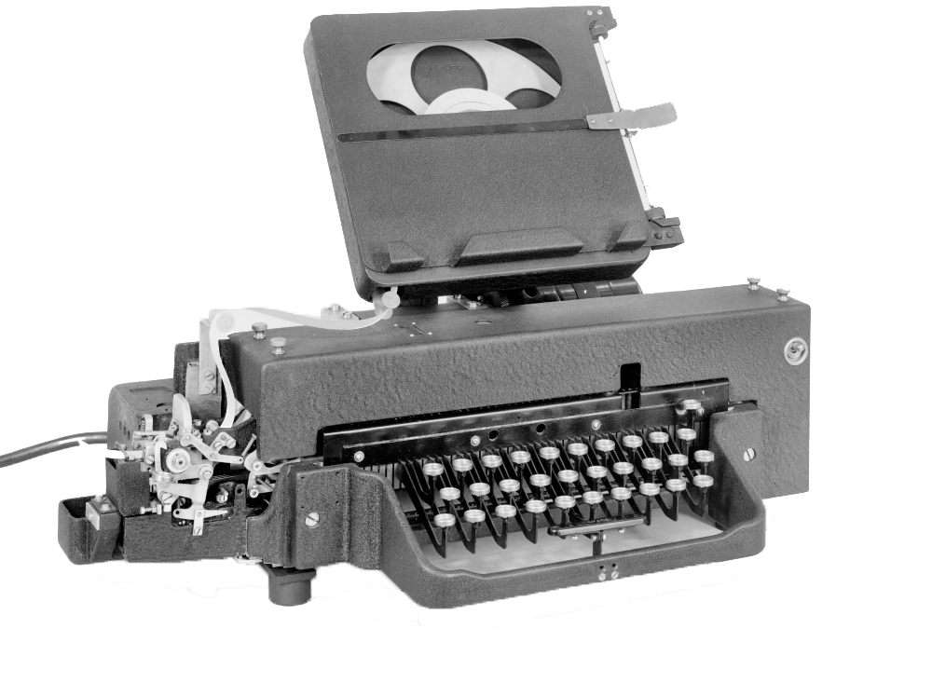
Key word: Teleprinter
This is a typewriter style machine that sent and received messages quickly over long distances.
The message was converted into a special code so it could be sent by radio waves.
Both sides of the conflict used teleprinters to plan their attack and defence.
Notes:
Teachers’ Notes
Each letter/character had its own binary code. Most teleprinters at this time used a 5-bit code – 5 ‘on’ or ‘off’ pulses.
We will look at binary code in more detail in activity four.

Slide 6
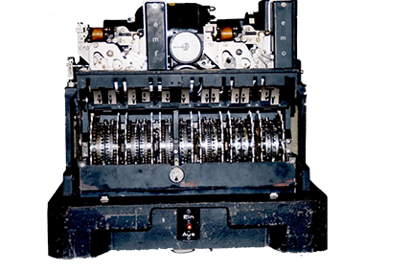
Key word: Encrypted
An encrypted message is when letters and numbers are disguised to make them hard to understand.
Messages were encrypted to keep them secret.
During the Second World War, sophisticated machines were used to make the encrypted messages.
Notes:
The image shows the German Lorenz machine used for encrypting messages sent between the German High Command, including Hitler.

Slide 7
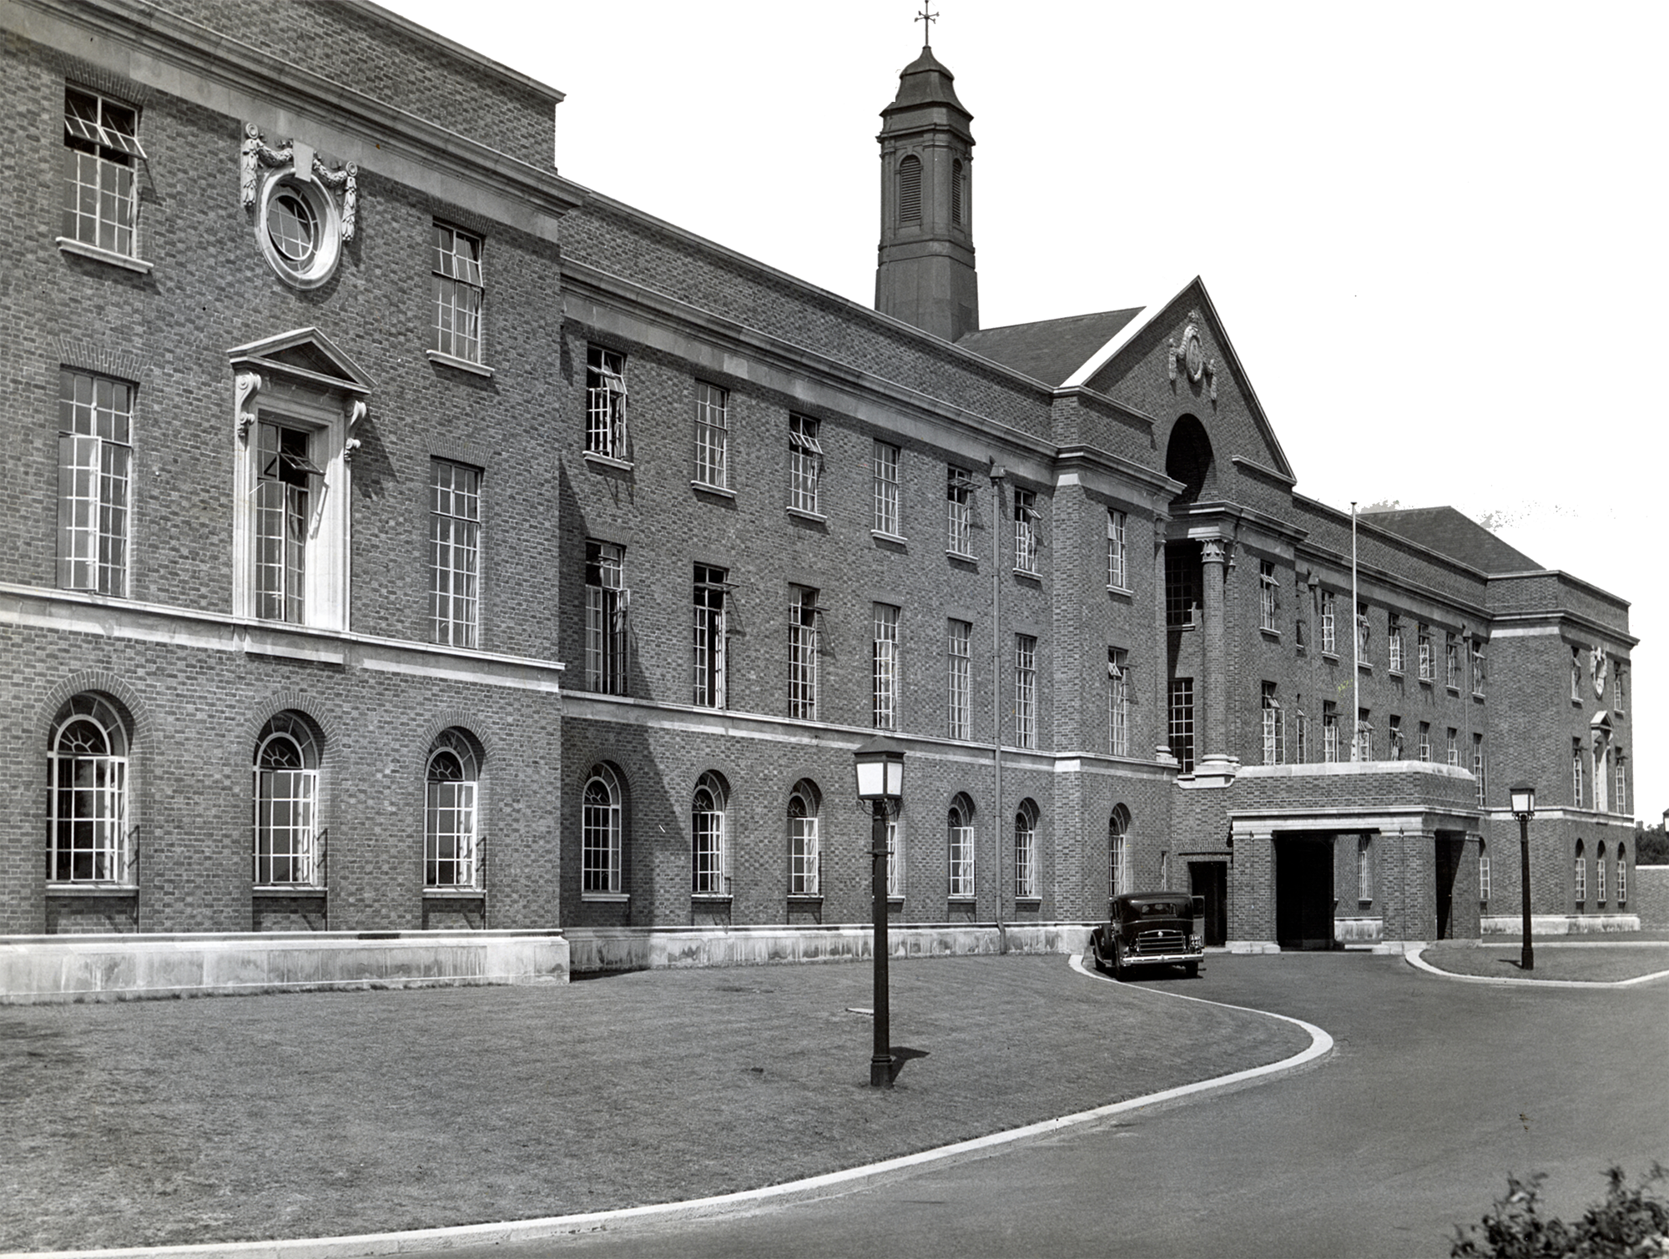
Have you got what it takes?
Only the best engineers were employed at the
Dollis Hill Research Station.
Let’s find out more about engineering skills…
Notes:
Teachers’ Notes
A research station is where people investigate, test and experiment in a particular subject.
The Dollis Hill Post Office Engineering Research Station is in North West London.
The Dollis Hill Post Office Engineering Research Station was used for communication and code breaking.

