Slide 2
The Postal Museum Learning Resource
Terms of Use
By downloading this PowerPoint and using these images you agree to The Postal Museum (TPM) and Royal Mail Group Ltd terms of use.
The material in this PowerPoint is provided for non-commercial and educational use in your classroom.
You can use the presentation or individual images in lessons and activities, and print out the images for use in your classroom.
You can share this presentation with other teachers for non-commercial and educational use in their classrooms.
Image credits must be included wherever the image is used. These are below each image, e.g. ©The Postal Museum 2010-0432/2
Non-The Postal Museum material is included at the agreement of the copyright holder and must also be credited, e.g. ©Courtesy of BT heritage and archives

Slide 3
©Paul Prescott/Shutterstock.com
Notes:
©Paul Prescott/Shutterstock.com
These posties in Sri Lanka are wearing flip flops to help keep their feet cool in the heat.

Slide 4
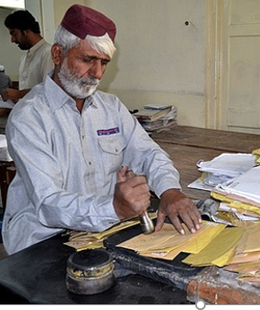
©Photoshot/age fotostock
Notes:
©Photoshot/age fotostock Postmen in Pakistan sort and stamp the mail.

Slide 5
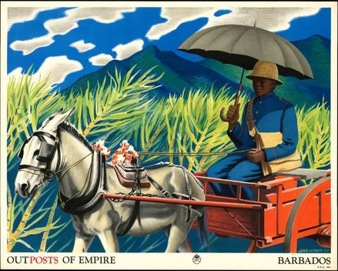
©Royal Mail Group Ltd, courtesy of The Postal Museum, POST 110/2497
Notes:
©Royal Mail Group Ltd, courtesy of The Postal Museum, POST 110/2497
This poster shows a postman in Barbados wearing a sunhat and carrying a parasol. It is one of a series of posters the Post Office produced in the 1930s for schools that show postmen from around the world.

Slide 6
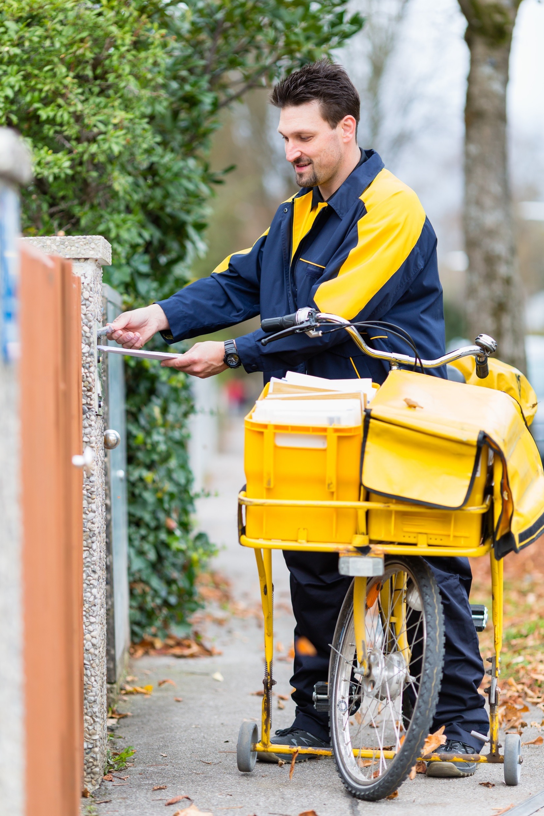
©Shutterstock
Notes:
©Shutterstock
This postie delivers his letters using a yellow trolley.

Slide 7
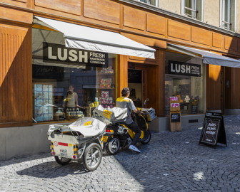
©Shutterstock
Notes:
©Shutterstock
This postie in Lausanne, Switzerland is delivering mail in the old town, with shops and people walking.

Slide 8
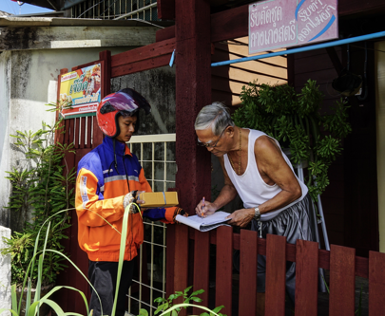
©Shutterstock
Notes:
©Shutterstock
A postie delivers a parcel in Chanthaburi, an old waterfront city in Thailand.

Slide 9
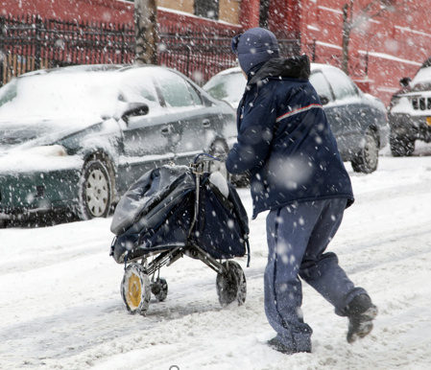
©Shutterstock
Notes:
©Shutterstock
The postie in the Bronx, New York delivers the post in a snow storm.

