Slide 2
The Postal Museum Learning Resource
Terms of Use
By downloading this PowerPoint and using these images you agree to The Postal Museum (TPM) and Royal Mail Group Ltd terms of use.
The material in this PowerPoint is provided for non-commercial and educational use in your classroom.
You can use the presentation or individual images in lessons and activities, and print out the images for use in your classroom.
You can share this presentation with other teachers for non-commercial and educational use in their classrooms.
Image credits must be included wherever the image is used. These are below each image, e.g. ©The Postal Museum 2010-0432/2
Non-The Postal Museum material is included at the agreement of the copyright holder and must also be credited, e.g. ©Courtesy of BT heritage and archives

Slide 3
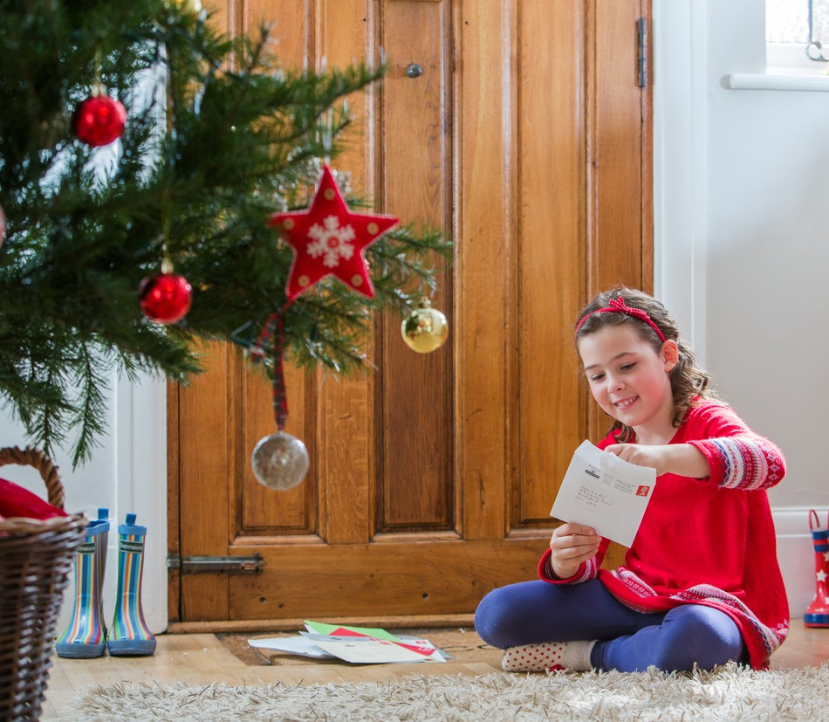
©Royal Mail Group Ltd
Notes:
©Royal Mail Group Ltd
A young girl waits for the Christmas post, and eagerly opens it on the door mat.

Slide 4
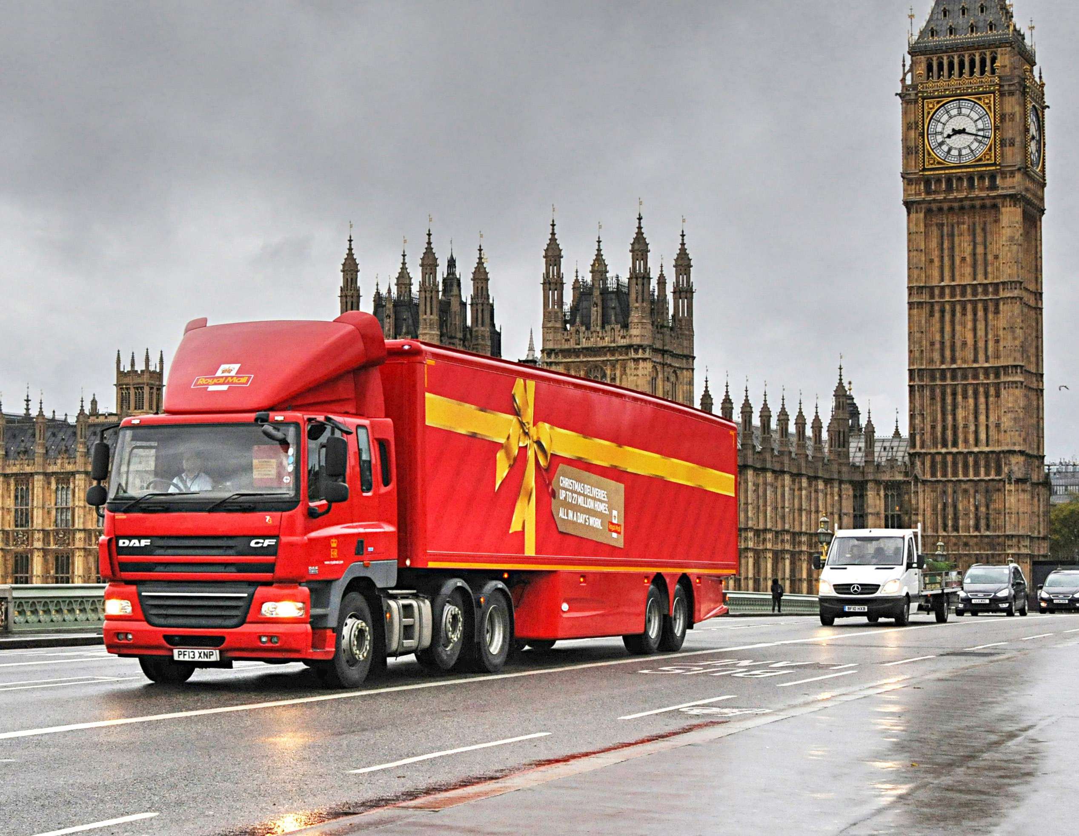
©Royal Mail Group Ltd
Notes:
©Royal Mail Group Ltd
A Royal Mail lorry wrapped up as a present drives through central London.

Slide 5
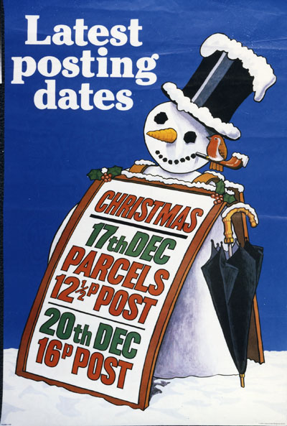
©Royal Mail Group Ltd, courtesy of The Postal Museum, POST 110/0187
Notes:
©Royal Mail Group Ltd, courtesy of The Postal Museum, POST 110/0187
This poster from the 1980s advertises the latest postal dates for Christmas.

Slide 6
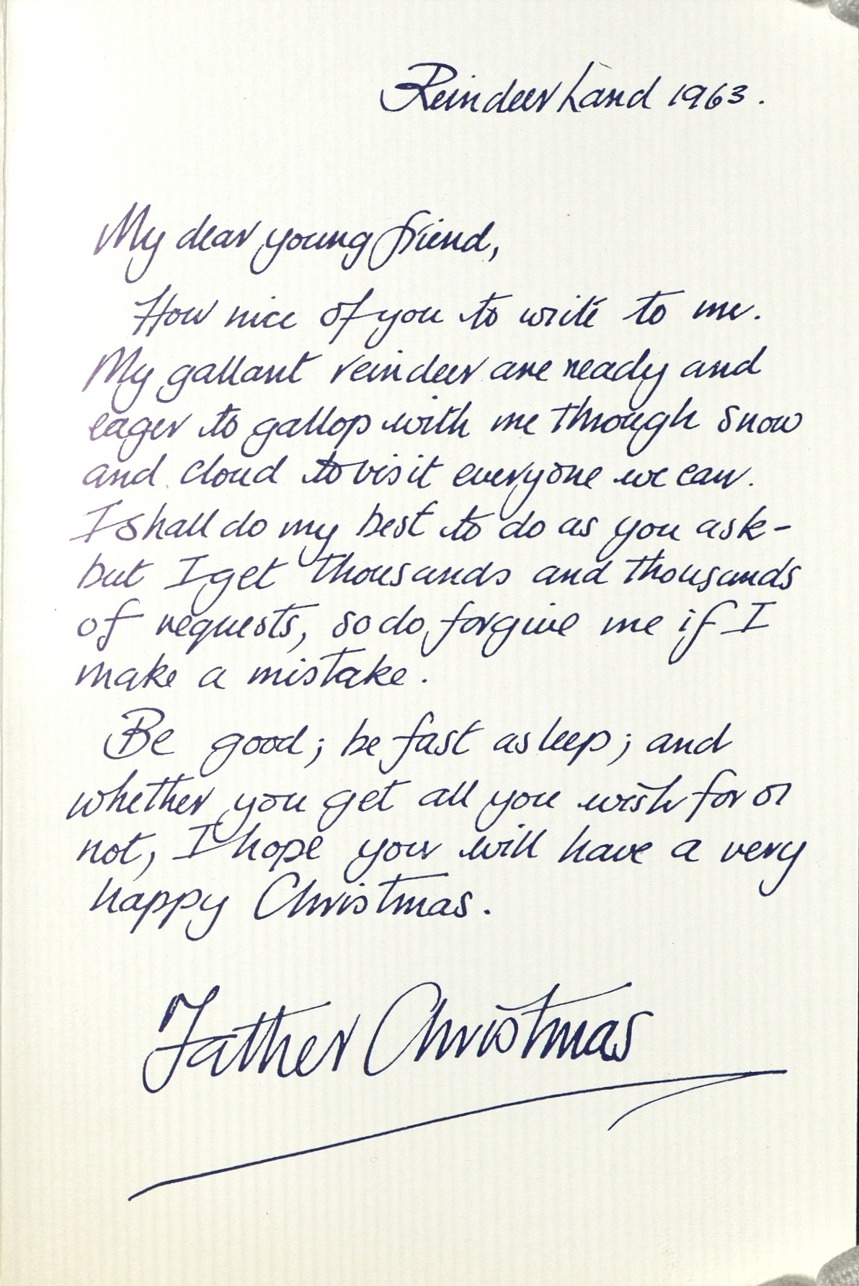
©Royal Mail Group Ltd
Notes:
©Royal Mail Group Ltd
An example of a reply from Father Christmas. Every child that writes to Father Christmas (Santa) using the Royal Mail scheme is guaranteed a reply.

Slide 7
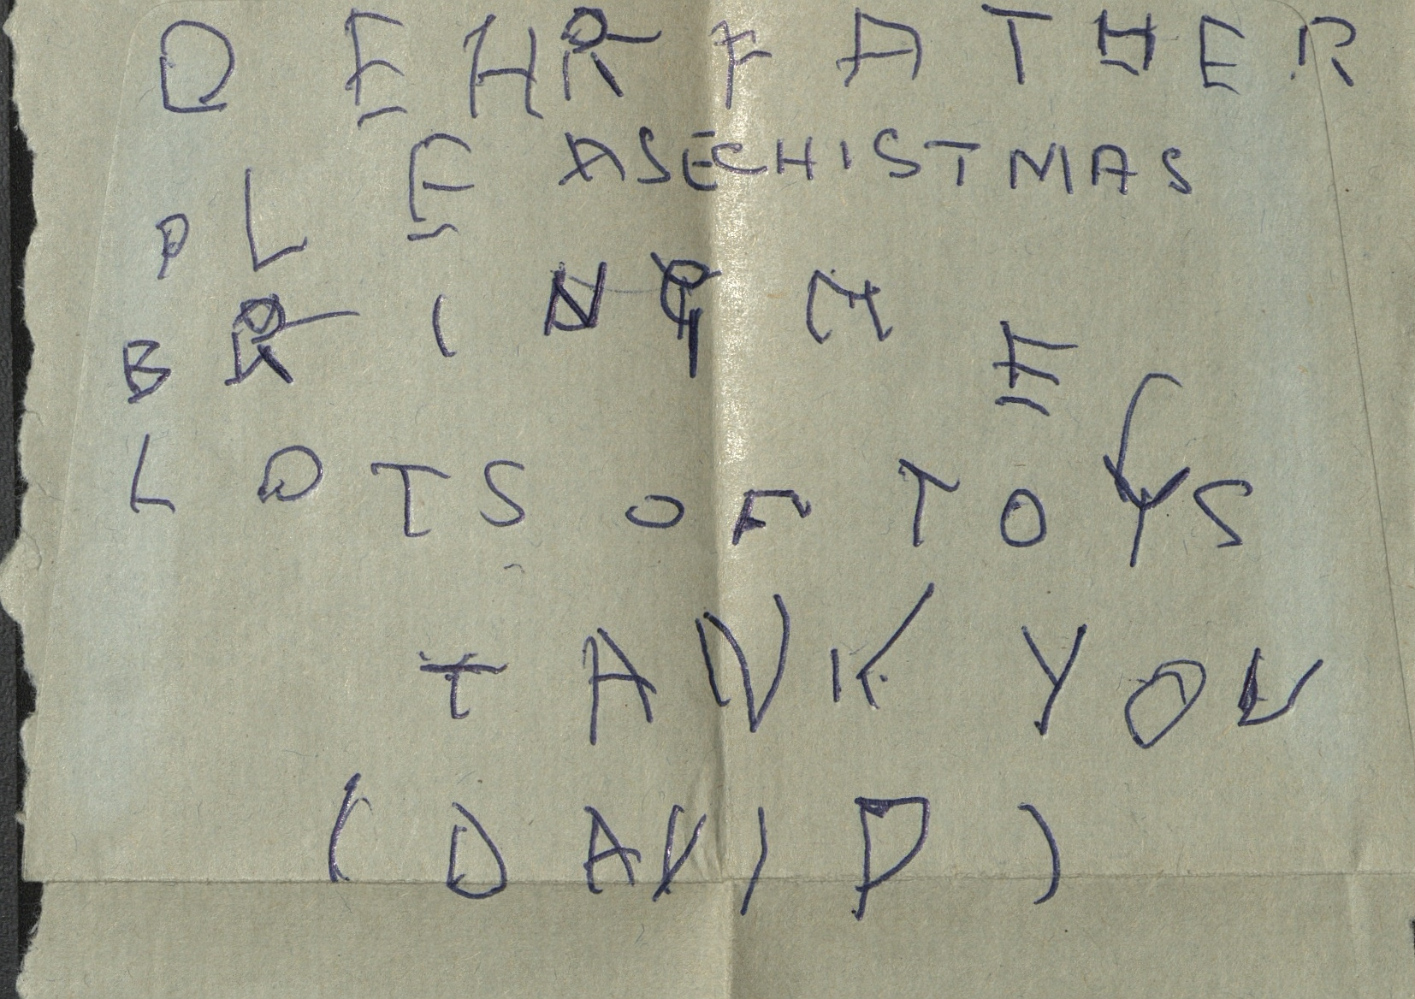
©The Postal Museum, POST 122/6341
Notes:
©The Postal Museum, POST 122/6341
This letter to Santa is from the 1960s. David aged 4, asks Father Christmas for LOTS OF TOYS.

Slide 8
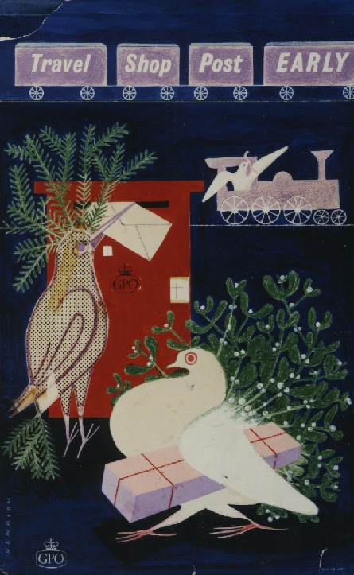
©Royal Mail Group Ltd, courtesy of The Postal Museum, POST 109/301
Notes:
©Royal Mail Group Ltd, courtesy of The Postal Museum, POST 109/301
This poster from the 1950s encourages people to travel, shop and post early for Christmas. Since the first Christmas card was sent in 1843 the Post Office have produced Christmas posters to encourage people to send their letters and presents early.

