Slide 2
The Postal Museum Learning Resource
Terms of Use
By downloading this PowerPoint and using these images you agree to The Postal Museum (TPM) and Royal Mail Group Ltd terms of use.
The material in this PowerPoint is provided for non-commercial and educational use in your classroom.
You can use the presentation or individual images in lessons and activities, and print out the images for use in your classroom.
You can share this presentation with other teachers for non-commercial and educational use in their classrooms.
Image credits must be included wherever the image is used. These are below each image, e.g. ©The Postal Museum 2010-0432/2
Non-The Postal Museum material is included at the agreement of the copyright holder and must also be credited, e.g. ©Courtesy of BT heritage and archives

Slide 3
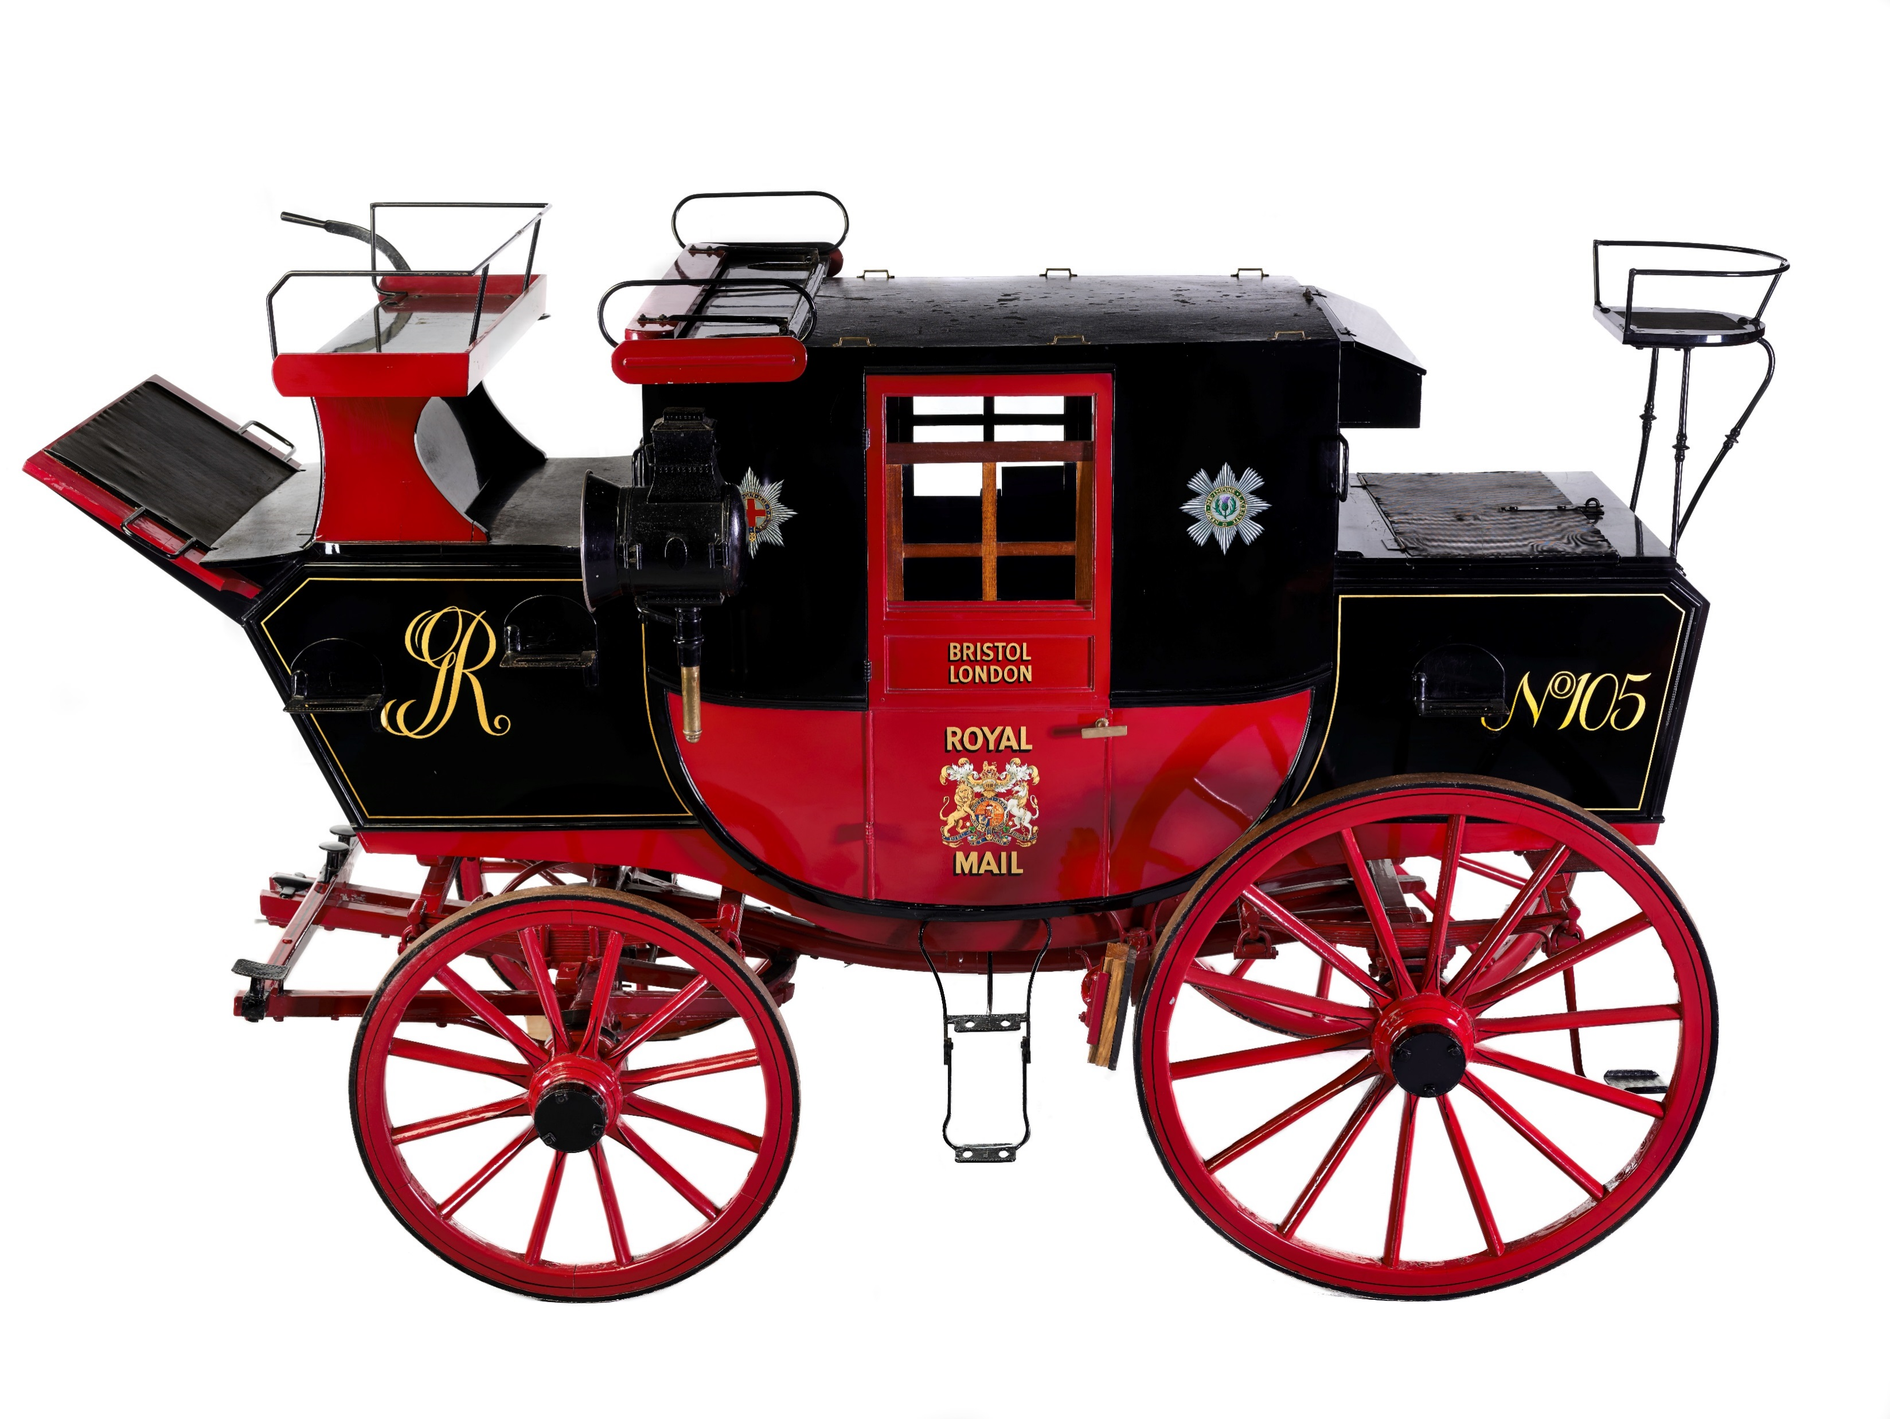
©The Postal Museum
Notes:
©The Postal Museum
This photograph is of the mail coach on display in The Postal Museum. Mail coach guards were employed by the Post Office to protect the mail. By the mid Victorian period (1850s) mail coaches had been replaced by the railways.

Slide 4
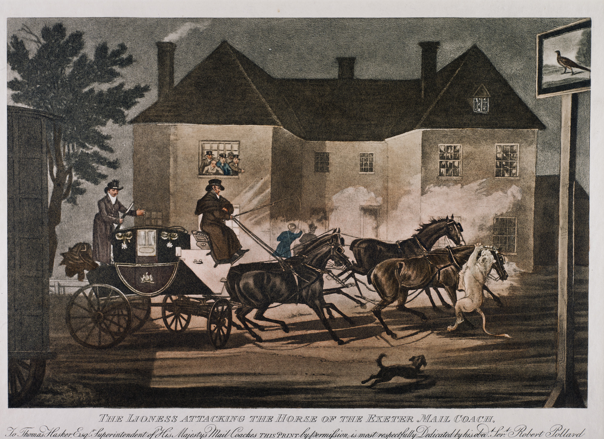
©The Postal Museum, 2009 – 0010
Notes:
©The Postal Museum, 2009 – 0010
This print shows the lioness attacking the Exeter mail coach. In the background is a large house with people at the window observing what is going on.

Slide 5
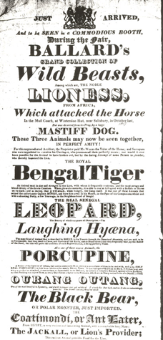
©Royal Mail Group Ltd, courtesy of The Postal Museum, POST 118
Notes:
©Royal Mail Group Ltd, courtesy of The Postal Museum, POST 118
This playbill for Ballard’s Circus lists the attractions including the LIONESS who attacked the mail coach.

