Slide 1
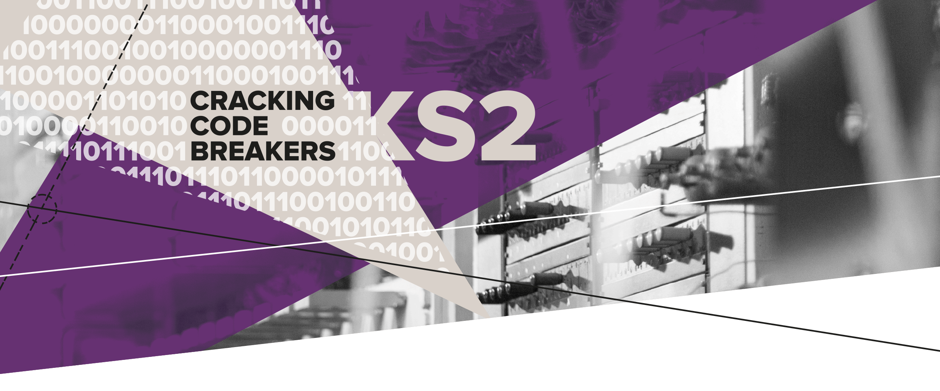
03 – Building Colossus
Key words:
Prototype | Blueprint | Valve

Slide 2

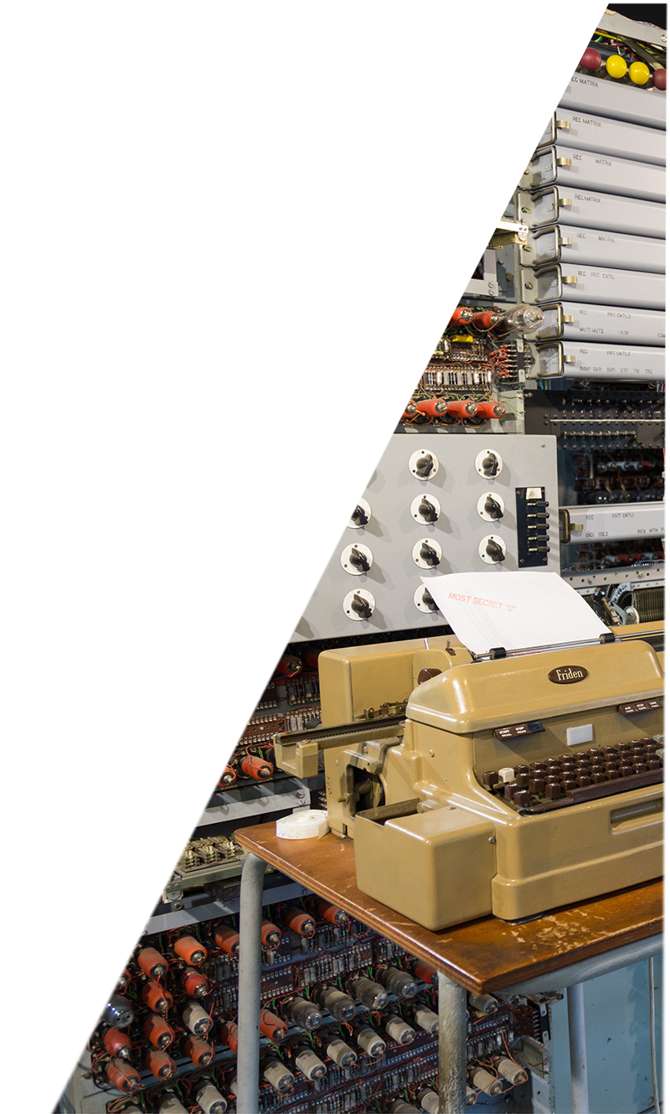

Computing during the Second World War
Colossus is believed to be the first programmable electronic digital computer. It was designed during the Second World War.
It was used to help to break coded messages sent between the top German generals, and to ultimately help win the war.
Notes:
Colossus was used to help the Allies on D-Day, a major turning point in the war.
A message, decoded with the help of Colossus, revealed German tanks were based at the chosen drop site for a US parachute division.
The site was changed to help secure D-Day success.

Slide 3
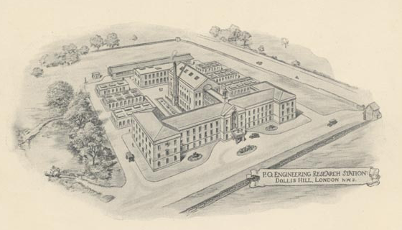
Key word: Prototype
A prototype is the first version of a device or machine ready for testing.
It took 10 months for Tommy and his team to build the Colossus prototype at the General Post Office (GPO) Engineering Research Centre at Dollis Hill.
Notes:
The first Colossus was built at the Post Office Research Station at Dollis Hill. It was later moved to Bletchley Park where more Colossi were built.

Slide 4
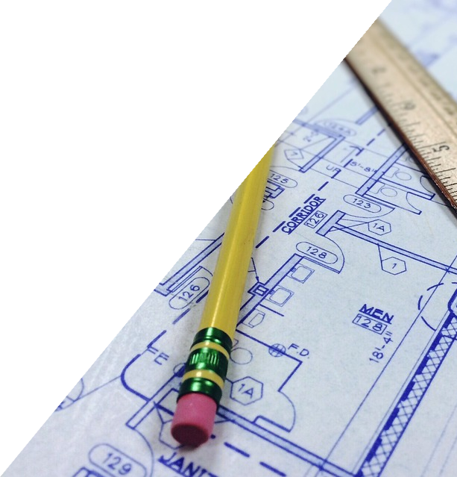
Key word: Blueprint
A blueprint is a technical drawing used for design and engineering.
It contains information that allows someone else to be able to construct the item.
Blueprints are usually drawn to scale.
Scale is a way of representing measurement.
Notes:
Teachers’ Notes
At the end of the war all the Colossus blueprints were destroyed.
We draw plans to scale so that all the information can fit onto the page or screen.
Scale is a the relationship between the distance on the map or drawing and the distance in real life.

Slide 5
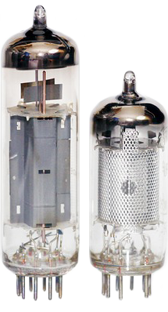
Key word: Valve
An electronic valve is a device that controls electric current and looks like a lightbulb.
A valve acts like a switch.
The first Colossus used 1600 valves!
Notes:
Tommy was an expert in valve technology – he had previously used them in telephone systems.

Slide 6
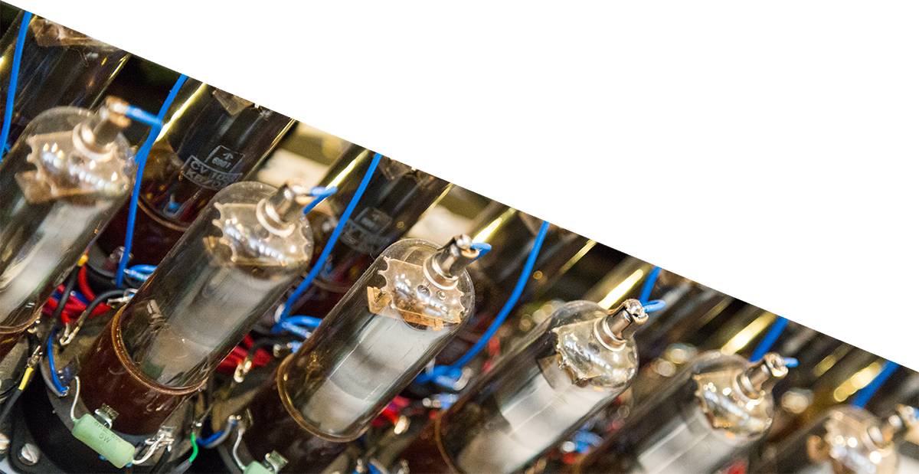
Scale up!
  Building the Colossus was a Top Secret operation.
  Tommy ripped up the Colossus blueprint so his different teams could work out the detail of each section.
  Use your knowledge of scale, shape and space
  to complete the Colossus activities.

