Slide 2
The Postal Museum Learning Resource
Terms of Use
By downloading this PowerPoint and using these images you agree to The Postal Museum (TPM) and Royal Mail Group Ltd terms of use.
The material in this PowerPoint is provided for non-commercial and educational use in your classroom.
You can use the presentation or individual images in lessons and activities, and print out the images for use in your classroom.
You can share this presentation with other teachers for non-commercial and educational use in their classrooms.
Image credits must be included wherever the image is used. These are below each image, e.g. ©The Postal Museum 2010-0432/2
Non-The Postal Museum material is included at the agreement of the copyright holder and must also be credited, e.g. ©Courtesy of BT heritage and archives

Slide 3
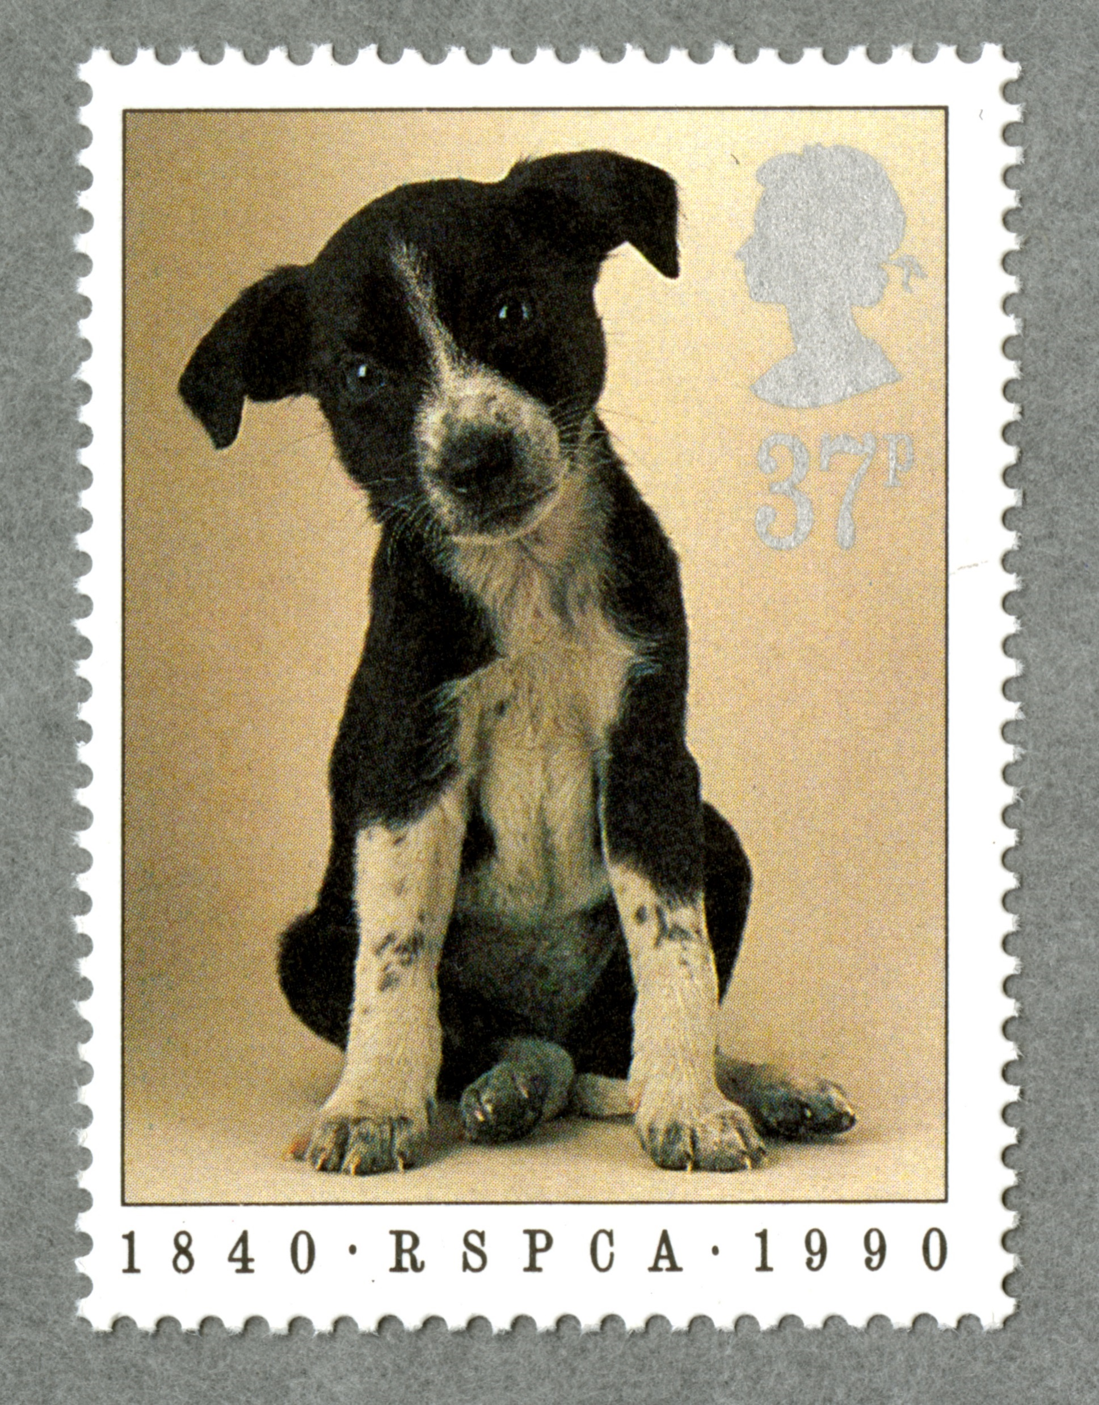
©Royal Mail Group Ltd
Notes:
©Royal Mail Group Ltd
This stamp from 1990 celebrates 150 years of the RSPCA charity (Royal Society for the Prevention of Cruelty to Animals)

Slide 4
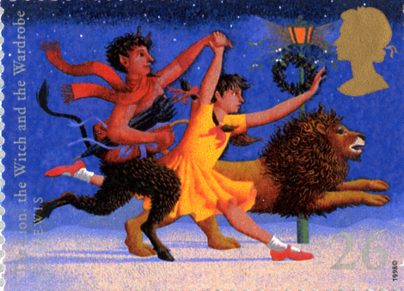
©Royal Mail Group Ltd
Notes:
©Royal Mail Group Ltd
This stamp is of The Lion, the Witch and the Wardrobe by C.S. Lewis. It is one of a series celebrating classic children’s fantasy novels.

Slide 5
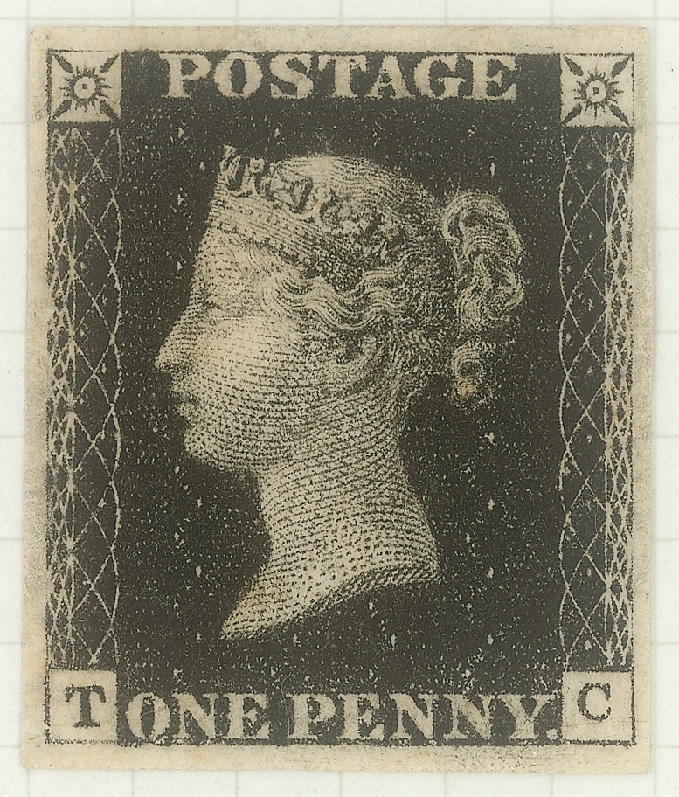
©Royal Mail Group Ltd, courtesy of The Postal Museum, POST 150
Notes:
©Royal Mail Group Ltd, courtesy of The Postal Museum, POST 150
The Penny Black stamp was the world’s first prepaid postage stamp introduced in 1840. It revolutionised the way people communicated because letters cost just one penny to anywhere in the UK. It led to a huge rise in the number of letters and an increase in literacy.

Slide 6
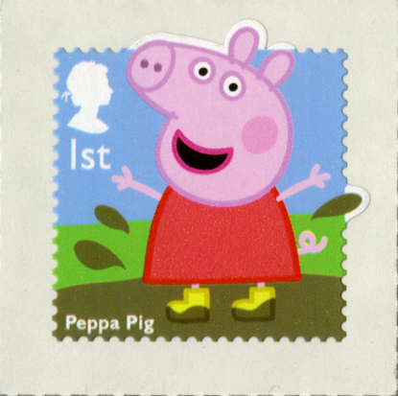
©Royal Mail Group Ltd, courtesy of The Postal Museum
Notes:
©Royal Mail Group Ltd, courtesy of The Postal Museum
This Peppa Pig stamp is part of a series celebrating children’s TV favourites.

Slide 7
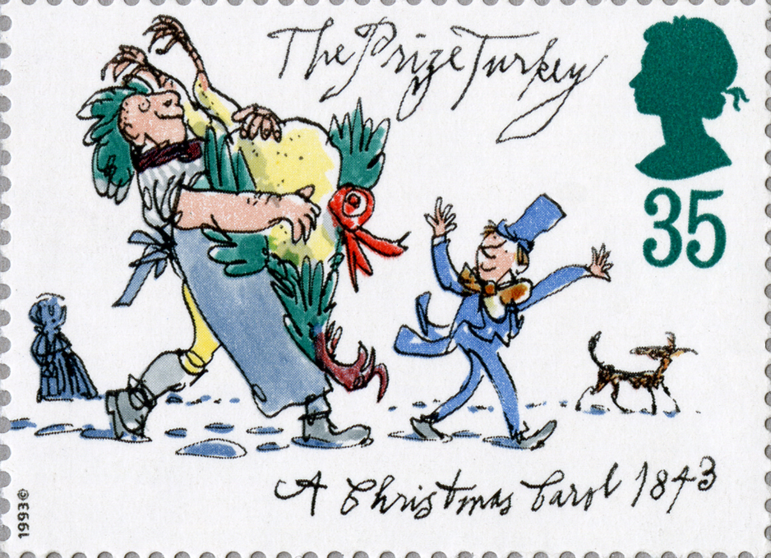
©Royal Mail Group Ltd
Notes:
©Royal Mail Group Ltd
This stamp celebrates the classic Christmas book A Christmas Carol by Charles Dickens. The book was published in 1843, the same year the World’s first Christmas card was printed.

Slide 8
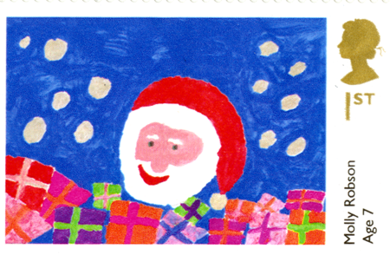
©Royal Mail Group Ltd
Notes:
©Royal Mail Group Ltd
This Christmas stamp from 2013 was designed by Molly Robson. Molly won a Christmas stamp design competition which had over 240,000 entries from primary school children throughout the UK.

Slide 9
©Royal Mail Group Ltd
Notes:
©Royal Mail Group Ltd
This Wallace and Gromit Christmas stamp is one of a set from 2010. Royal Mail designers worked closely with Nick Park, creator of Wallace and Gromit to produce the set.

