Slide 2
The Postal Museum Learning Resource
Terms of Use
By downloading this PowerPoint and using these images you agree to The Postal Museum (TPM) and Royal Mail Group Ltd terms of use.
The material in this PowerPoint is provided for non-commercial and educational use in your classroom.
You can use the presentation or individual images in lessons and activities, and print out the images for use in your classroom.
You can share this presentation with other teachers for non-commercial and educational use in their classrooms.
Image credits must be included wherever the image is used. These are below each image, e.g. ©The Postal Museum 2010-0432/2
Non-The Postal Museum material is included at the agreement of the copyright holder and must also be credited, e.g. ©Courtesy of BT heritage and archives

Slide 3
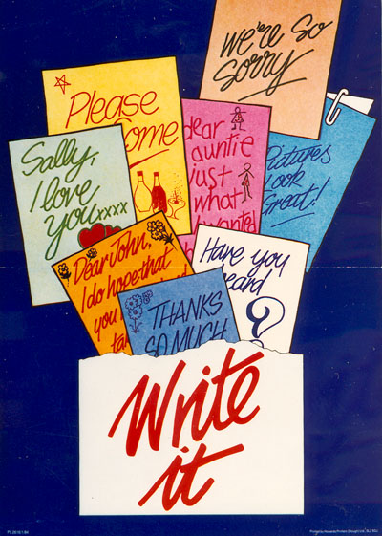
©Royal Mail Group Ltd, courtesy of The Postal Museum, POST 110/0190
Notes:
©Royal Mail Group Ltd, courtesy of The Postal Museum, POST 110/0190
This poster promotes sending letters with a simple slogan to Write it.

Slide 4
©Royal Mail Group Ltd, courtesy of The Postal Museum, POST 109/151
Notes:
©Royal Mail Group Ltd, courtesy of The Postal Museum, POST 109/151
This poster from the 1950s uses an image of children’s BLOCK LETTERS to encourage people to address their post clearly.

Slide 5
©Royal Mail Group Ltd, courtesy of The Postal Museum, POST 110/0014
Notes:
©Royal Mail Group Ltd, courtesy of The Postal Museum, POST 110/0014
This poster uses a cartoon postman to advertise the benefits of correct addressing.

Slide 6
©Royal Mail Group Ltd, courtesy of The Postal Museum, POST 110/0388
Notes:
©Royal Mail Group Ltd, courtesy of The Postal Museum, POST 110/0388
This poster uses a friendly house illustration to promote using your postcode.

Slide 7
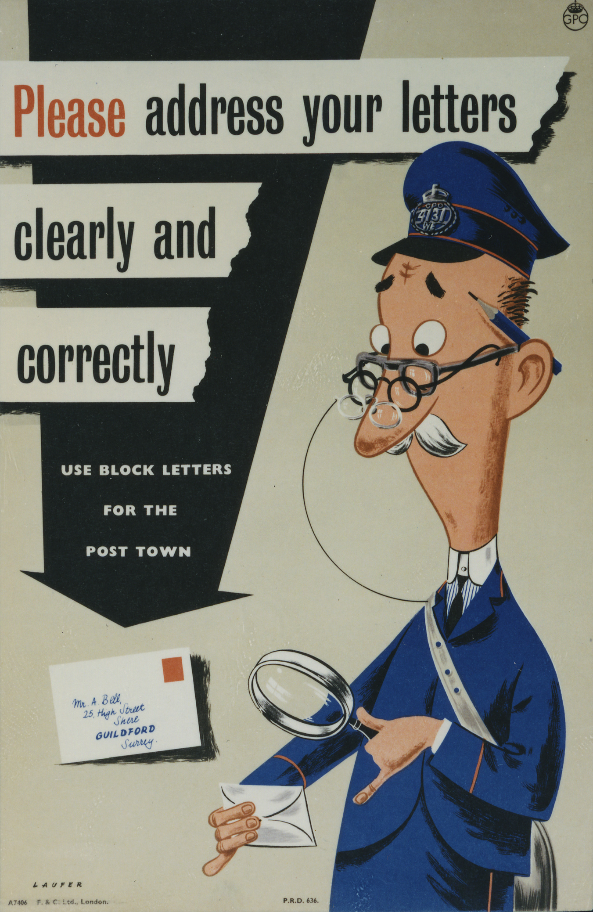
©Royal Mail Group Ltd, courtesy of The Postal Museum, POST 110/1271
Notes:
©Royal Mail Group Ltd, courtesy of The Postal Museum, POST 110/1271
This poster advises on the correct addressing of letters. It features a postman wearing three pairs of glasses, holding a magnifying glass to read a letter.

Slide 8
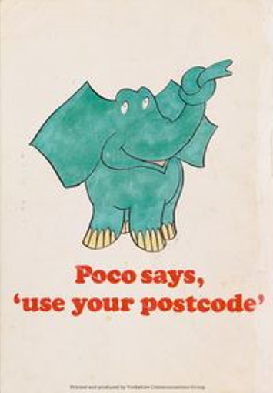
©The Postal Museum, 2006 – 0272
Notes:
©The Postal Museum, 2006 – 0272
This is the front cover of a children’s leaflet from the 1970s. It encouraged children to find out their postcode. Inside the leaflet children could follow the story of a letter to see if it arrived safely.

Slide 9
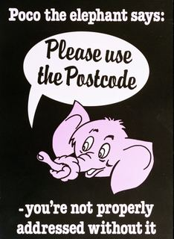
©Royal Mail Group Ltd, courtesy of The Postal Museum, POST 110/30378
Notes:
©Royal Mail Group Ltd, courtesy of The Postal Museum, POST 110/30378
This poster shows Poco the Elephant. A friendly character introduced in the 1970s to encourage the use of your postcode.

